Slide 1
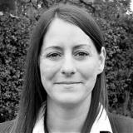
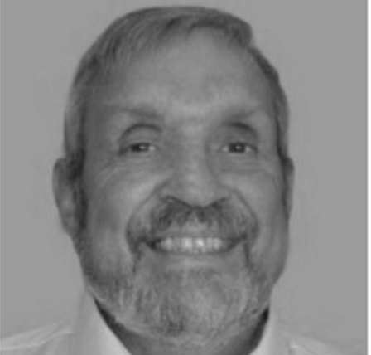
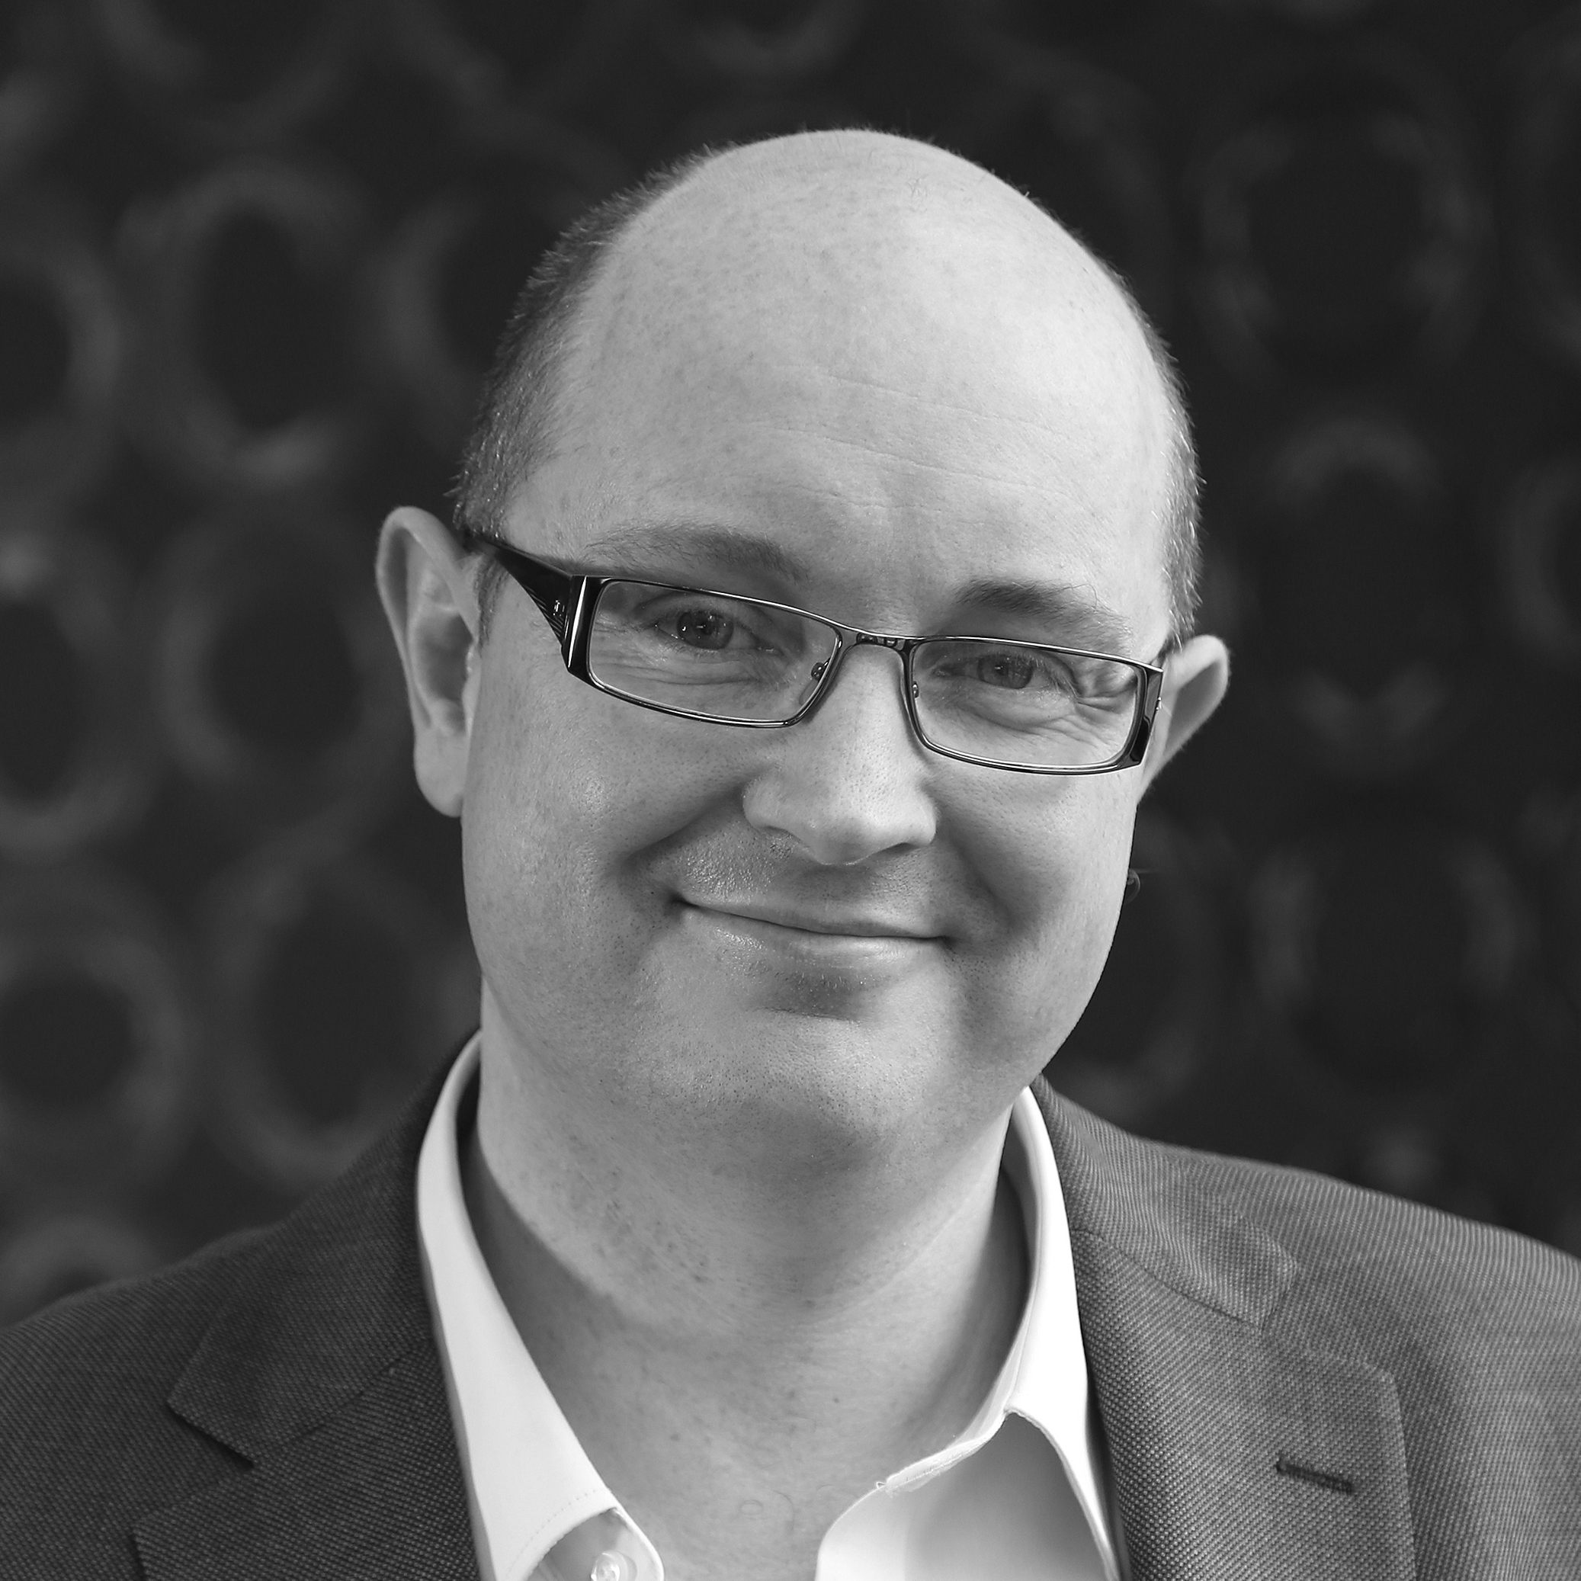

Welcome
Webinar: What travel managers would tell their younger selves
Our Panel
Nicola Spence
Construction industry
Ole Mortensen
AMM Consulting
Chris Pouney
Nina and Pinta
If you have a question for our panel…
Tweet: @BizTraveliQ #btiqlive
Or ensure this symbol is blue and fill the box to the right of your screen

Slide 2

  Understand your business culture and goals

Slide 3

  Learn the context of travel

Slide 4
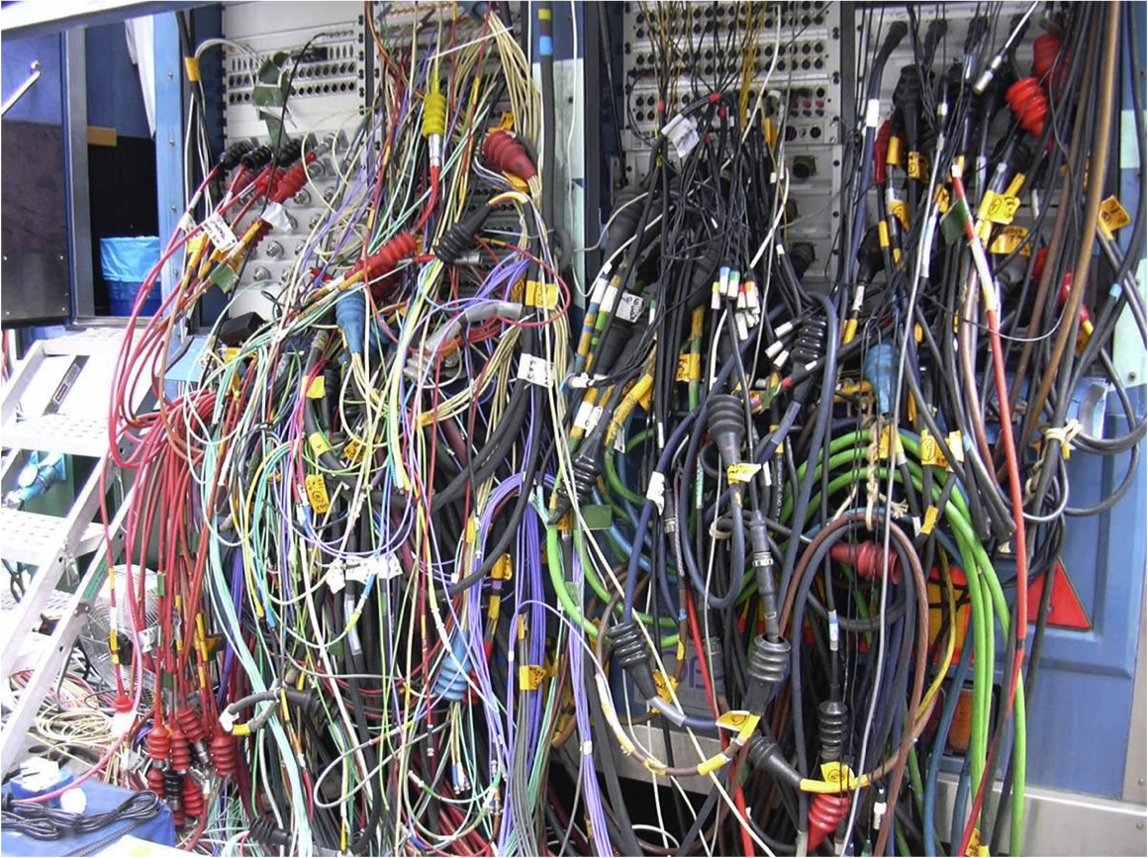
  Make sure you keep aware of new tools and technology

Slide 5
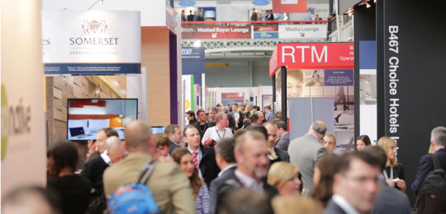
  Keep pace with the industry

Slide 6
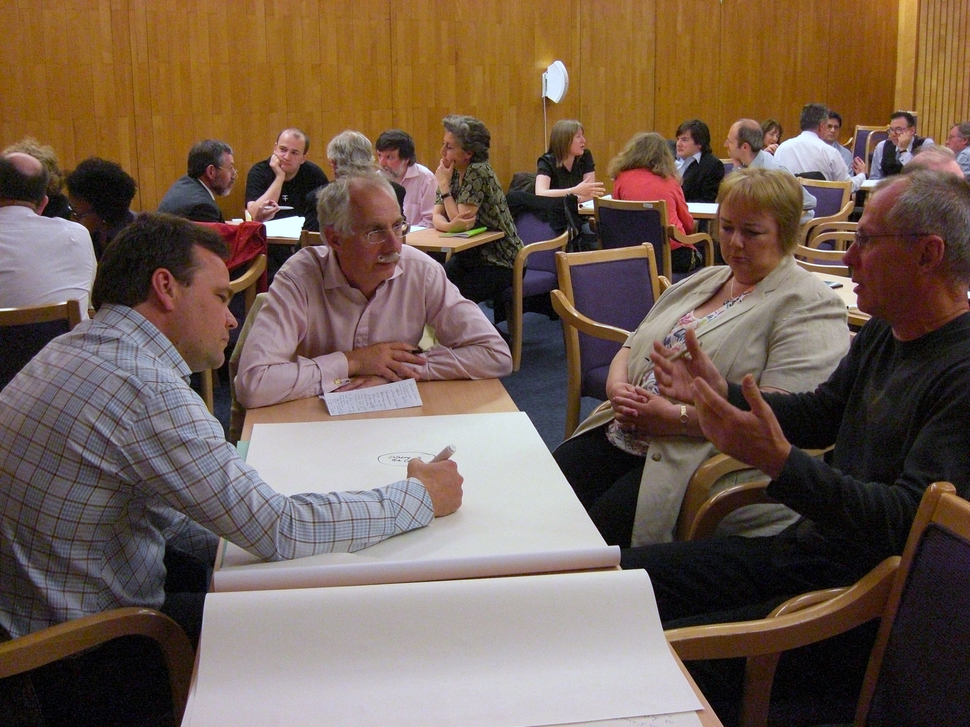
  Have conversations with
  non-travel people

Slide 7
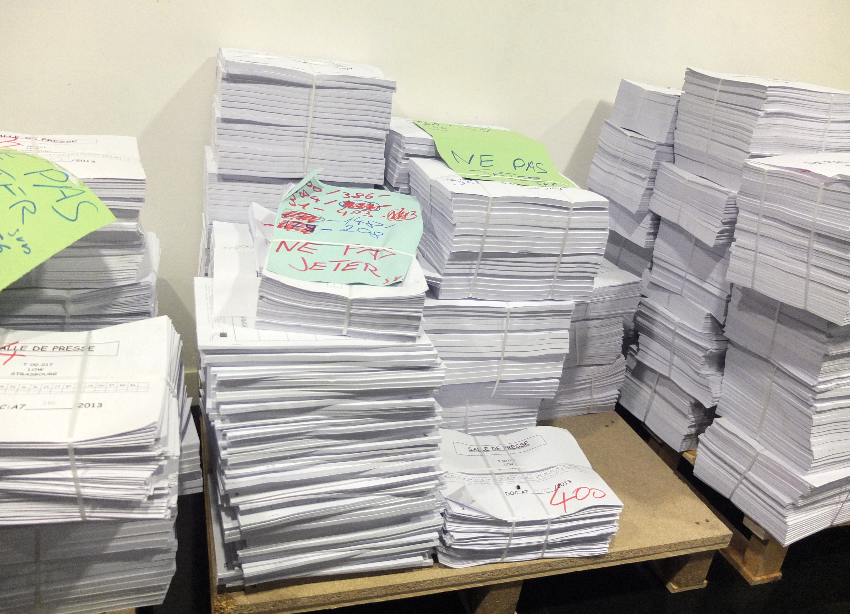
  Have a clear travel policy that works for your industry

Slide 8
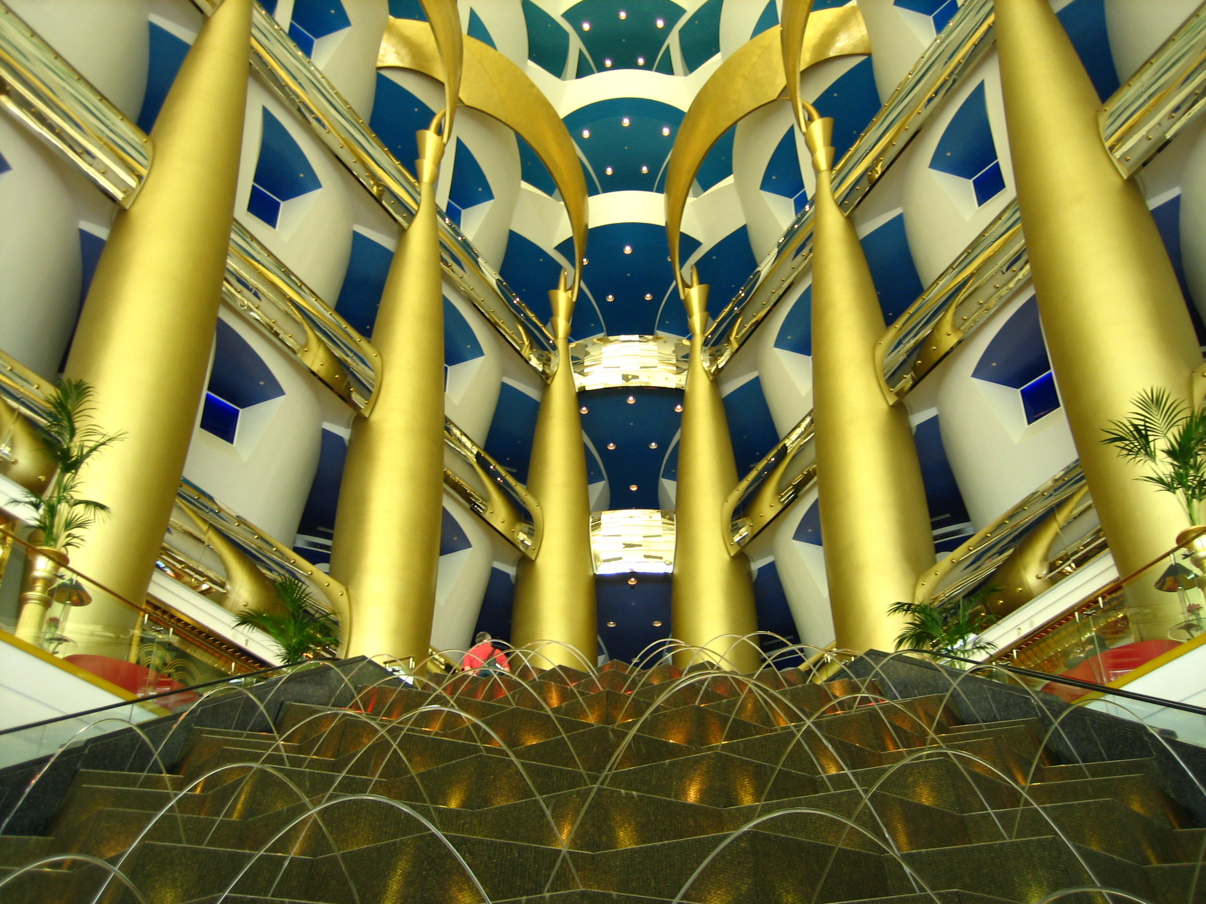
  Don’t get too hung up on having 100% compliance

Slide 9
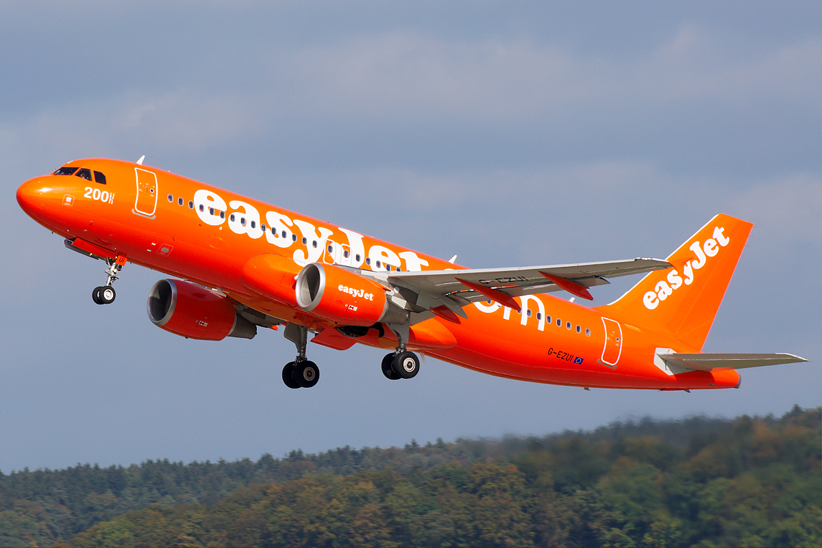
  I wish I had realised how much of an impact Open Skies would make

Slide 10
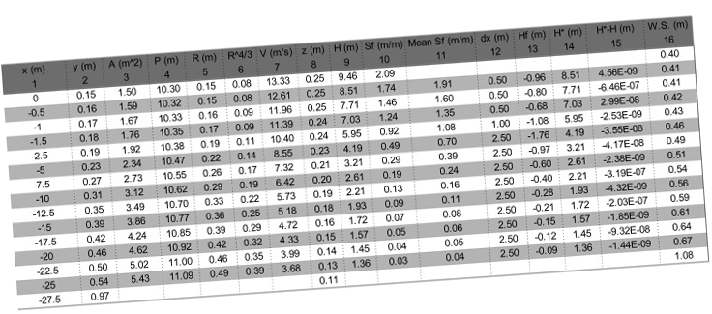
Photo: Craig Murphy
  Understand your numbers

Slide 11
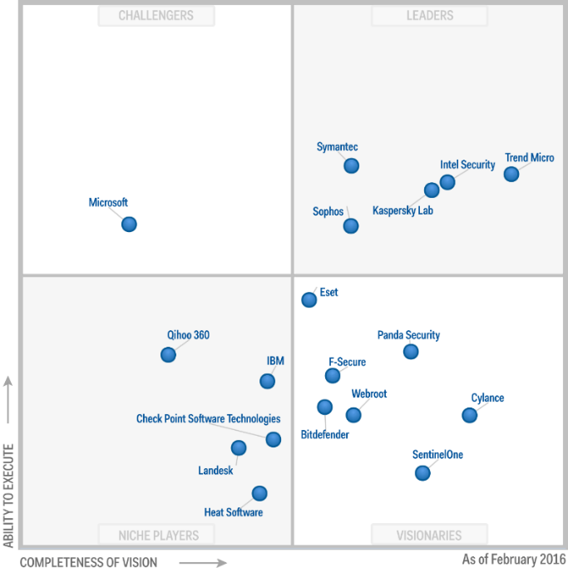
  The power of benchmarking

Slide 12
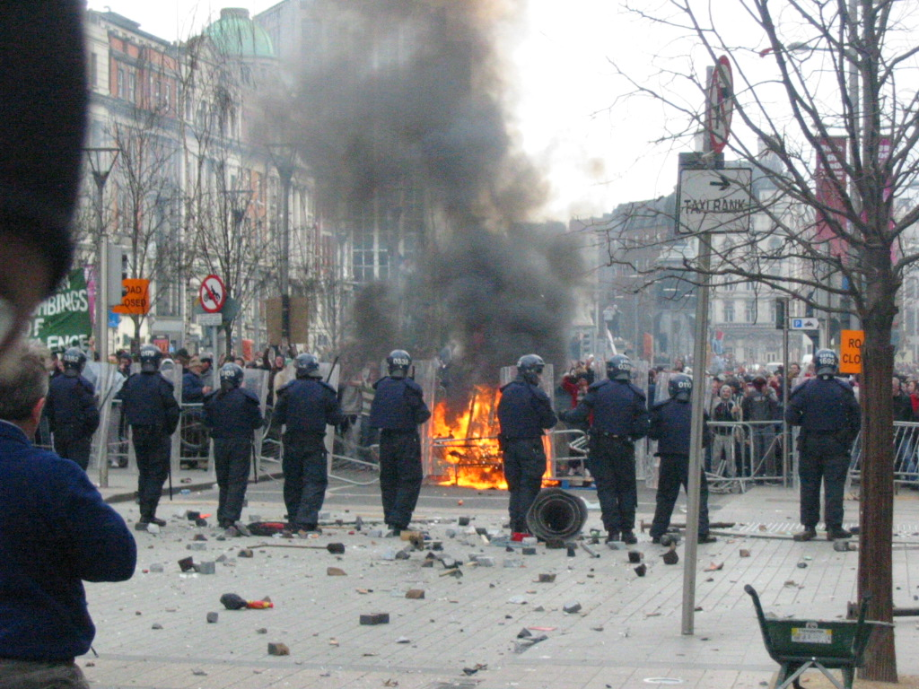
  Recognise the importance of duty of care

Slide 13
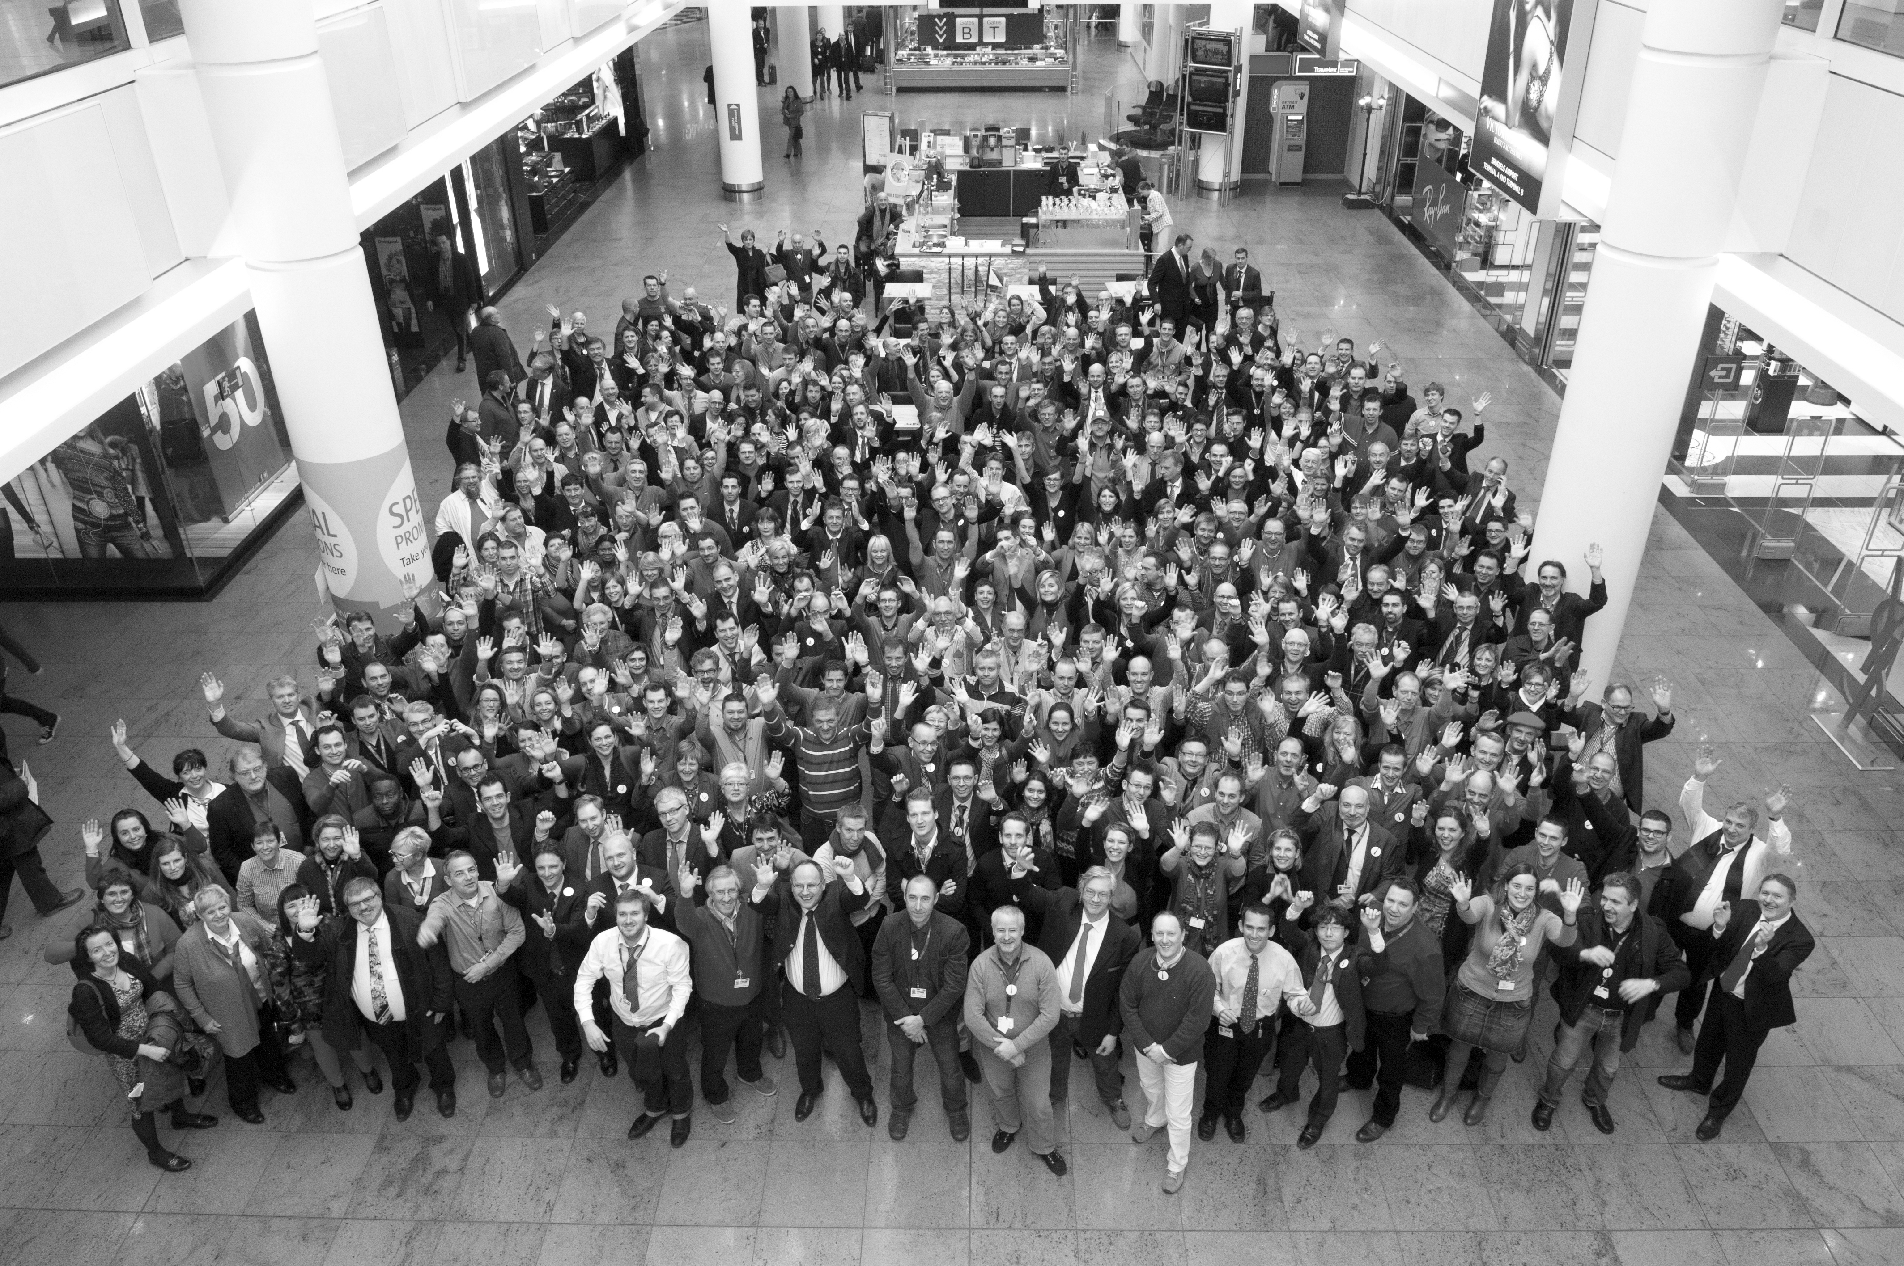
Realise that stakeholder management is critical

Slide 14
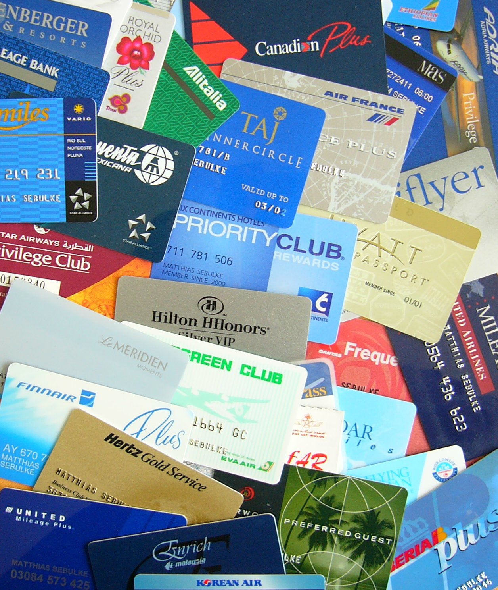
Recognise why travellers like loyalty programmes

Slide 15
Thank you
Our Panel
Nicola Spence
Construction industry
Ole Mortensen
AMM Consulting
Chris Pouney
Nina and Pinta
See more at www.businesstravel-iq.com

Slide 16

Our next webinar
Choosing the right KPIs for your travel programme
Friday 30th September at 11am

