Slide 1
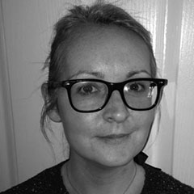
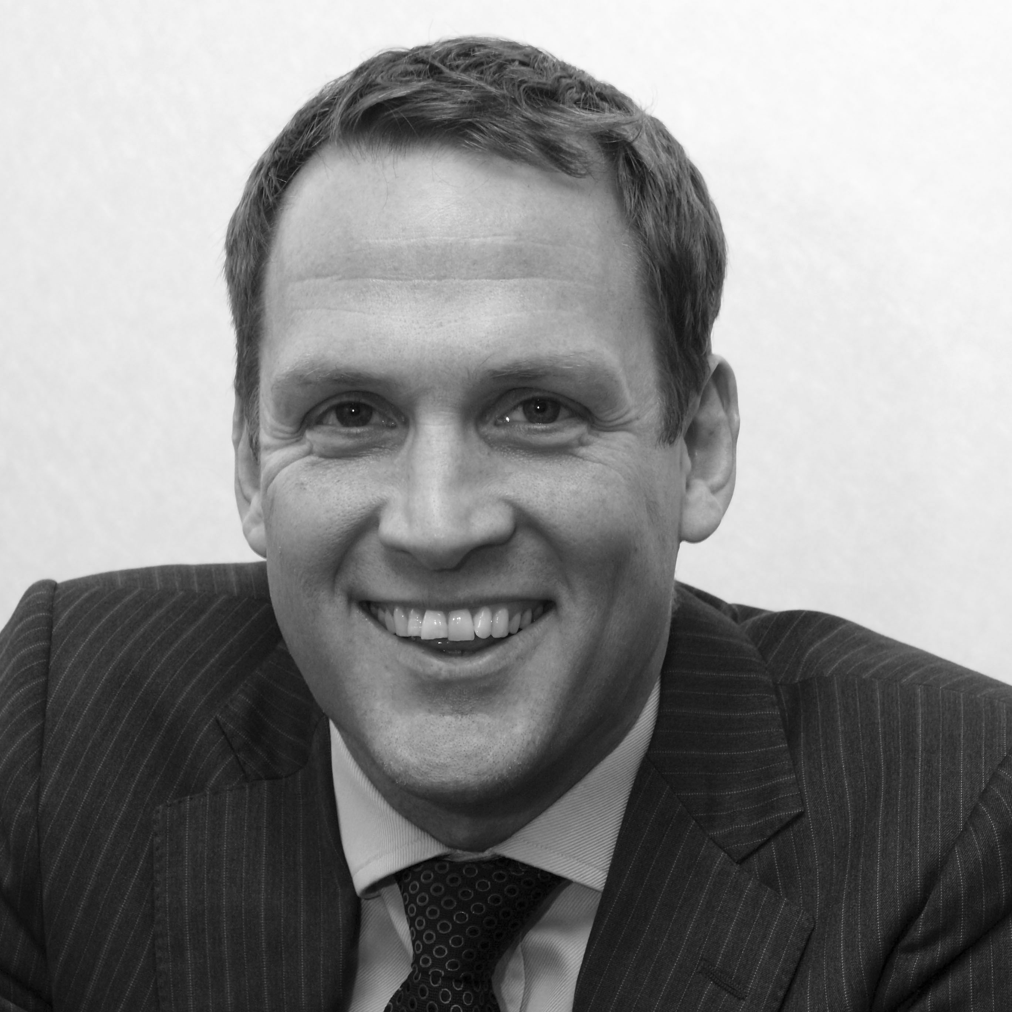
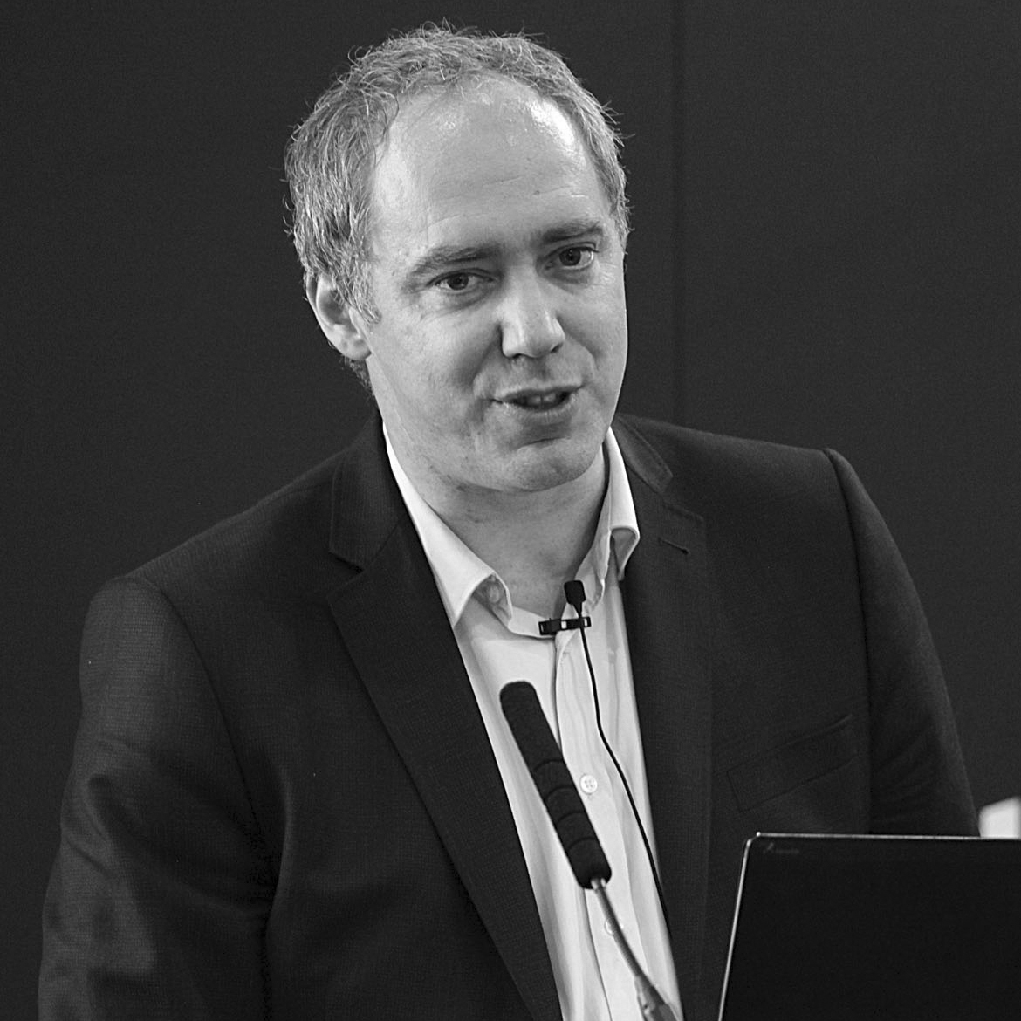

Welcome
Webinar: Does social media have a place in business travel?
Our Panel
Angela Smith
Carillion
Adam Knights
ATPI
Mark Frary
Business Travel iQ
If you have a question for our panel…
Tweet: @BizTraveliQ #btiqlive
Or ensure this symbol is blue and fill the box to the right of your screen

Slide 2
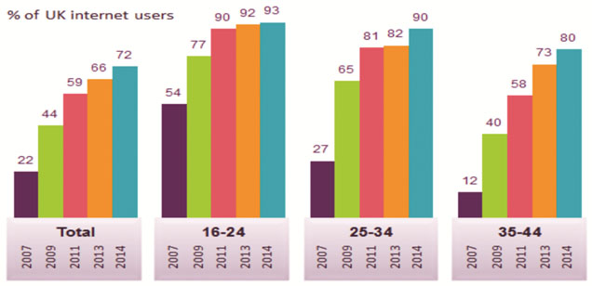
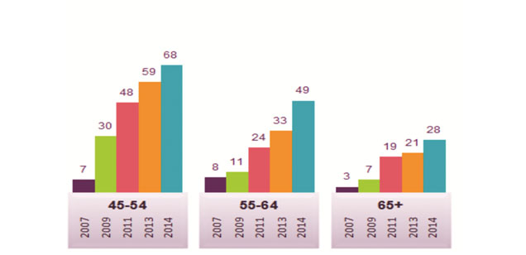
No-one in business travel uses social media
Source: Ofcom

Slide 3
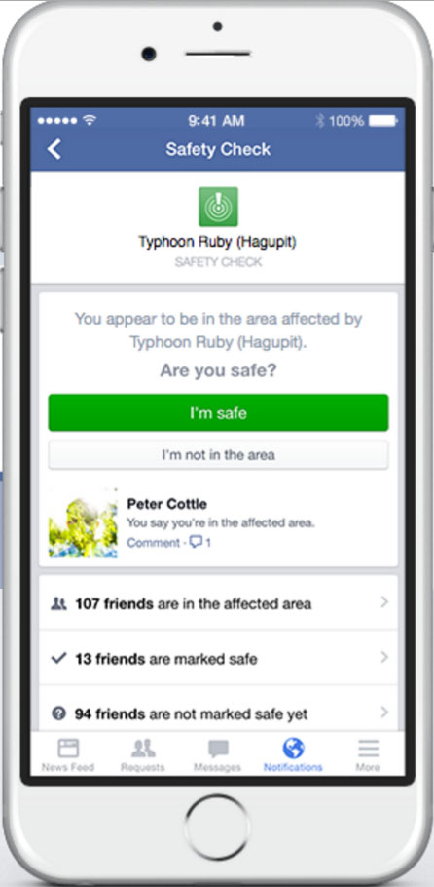

No-one in business travel uses social media
Facebook Safety Check

Slide 4
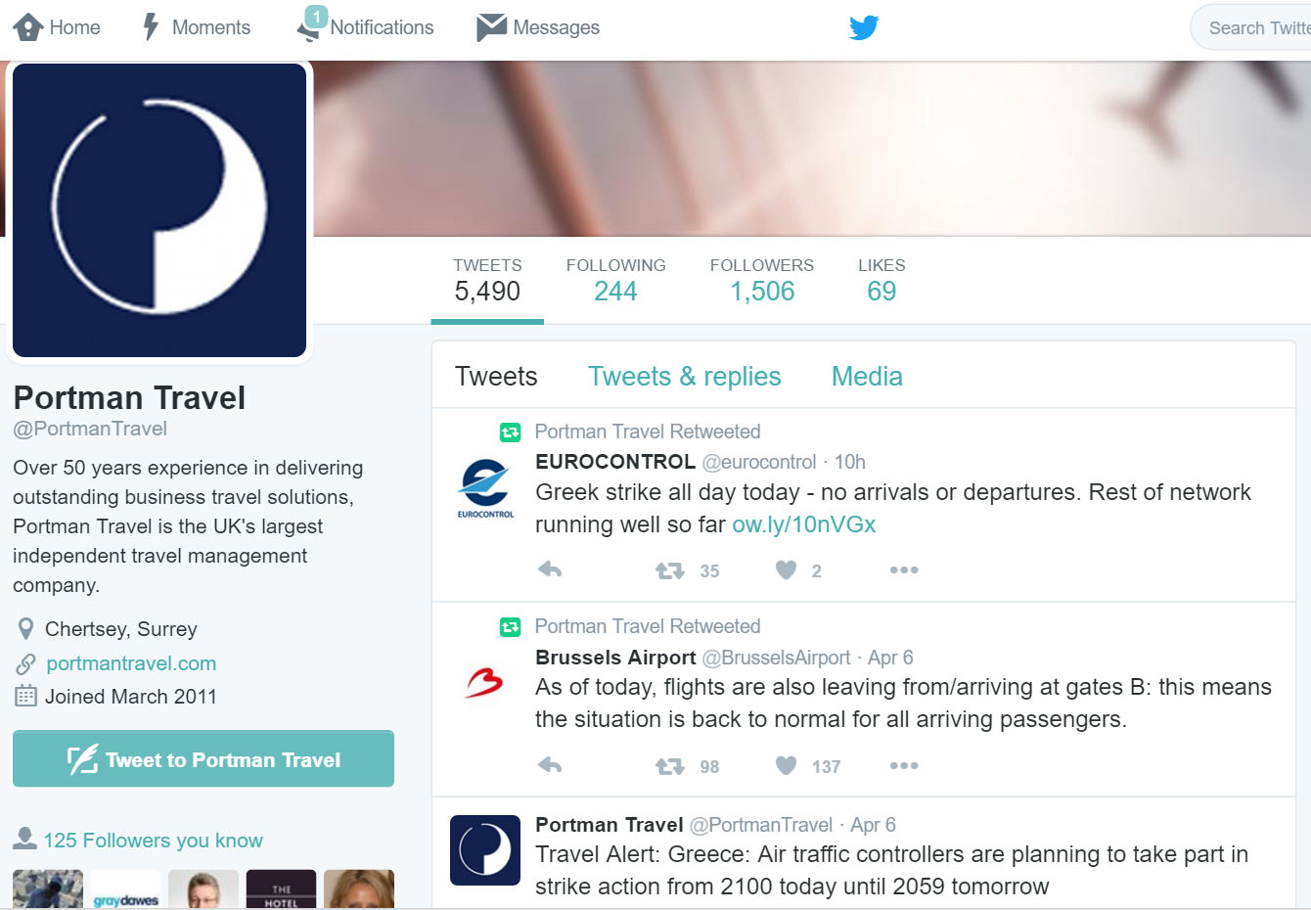
No-one in business travel uses social media
Real-time travel disruption news

Slide 5
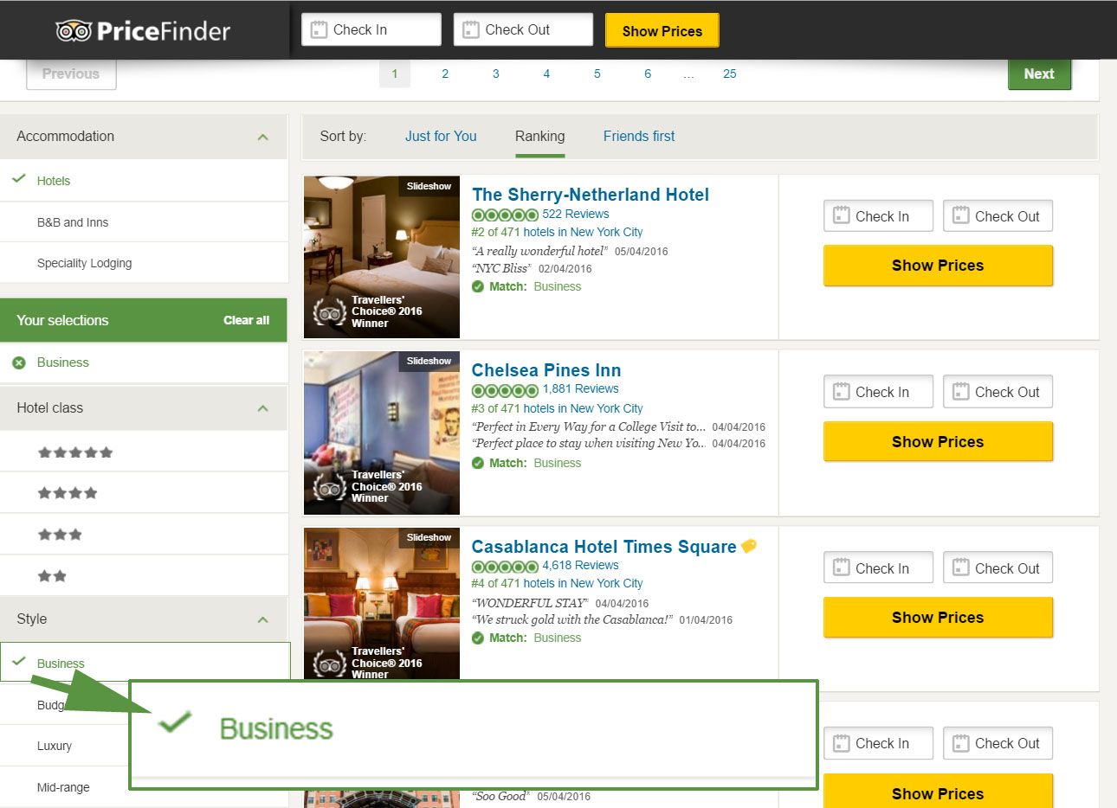
No-one in business travel uses social media
TripAdvisor has millions of business hotel reviews

Slide 6
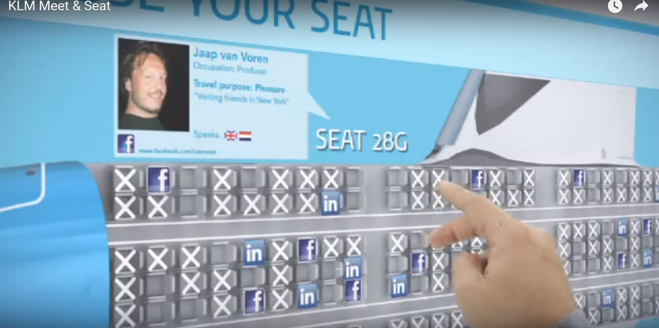
No-one in business travel uses social media
Sit next to someone interesting on KLM

Slide 7

An anti-social network?

Slide 8
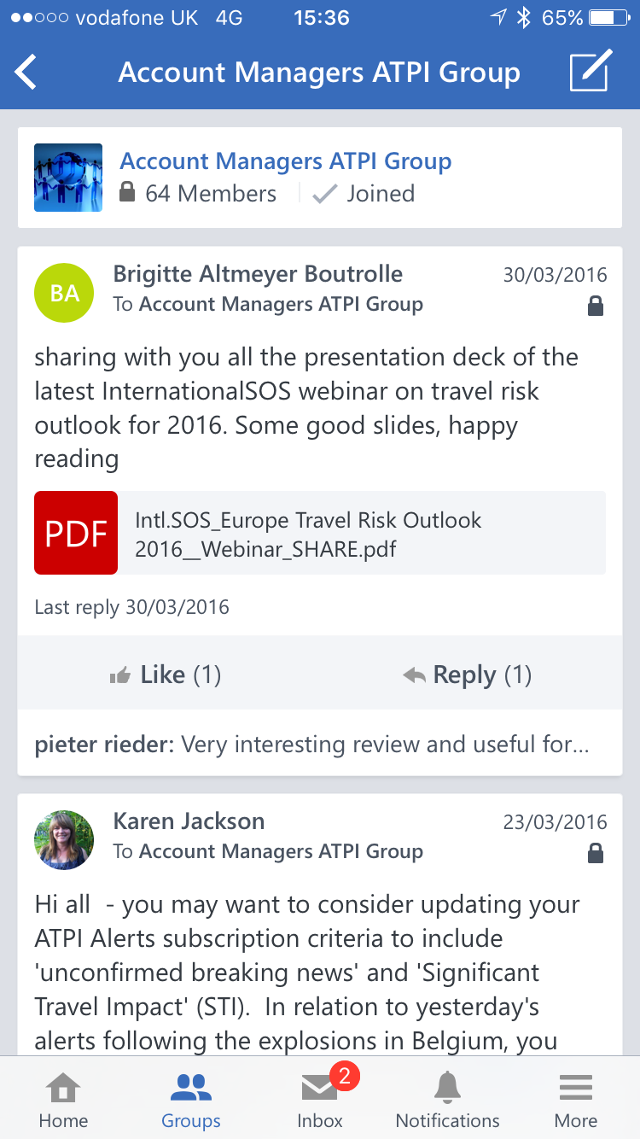
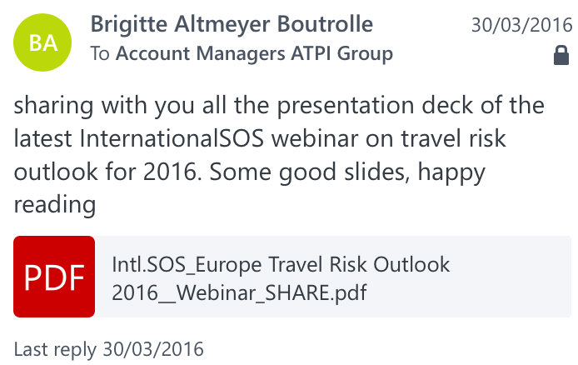
ATPI and Yammer

Slide 9
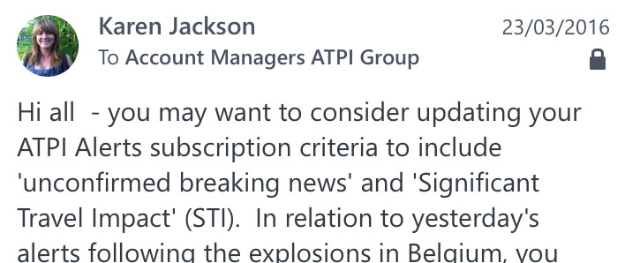
ATPI and Yammer

Slide 10
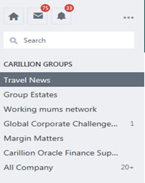
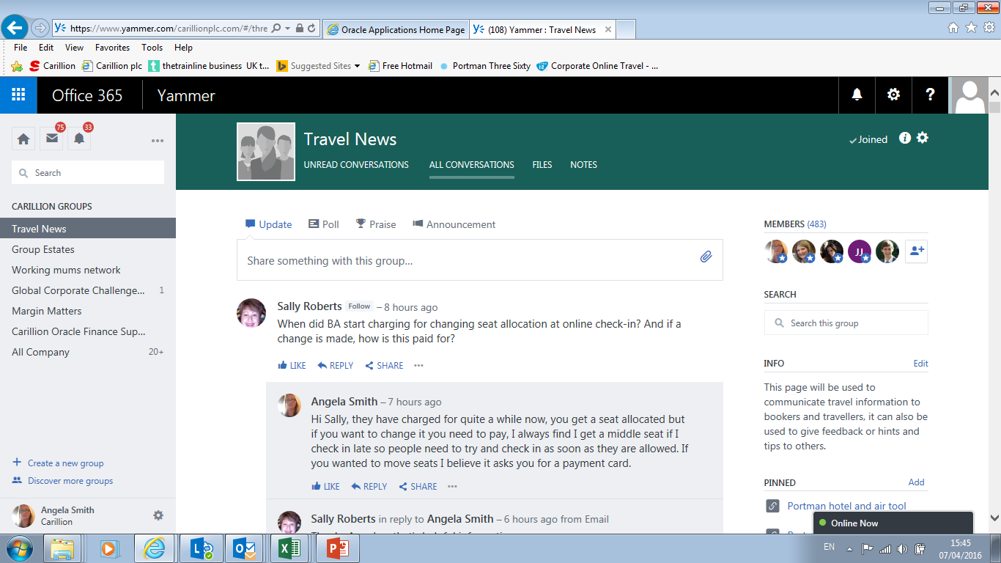
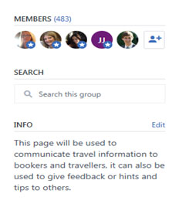
Carillion and Yammer

Slide 11
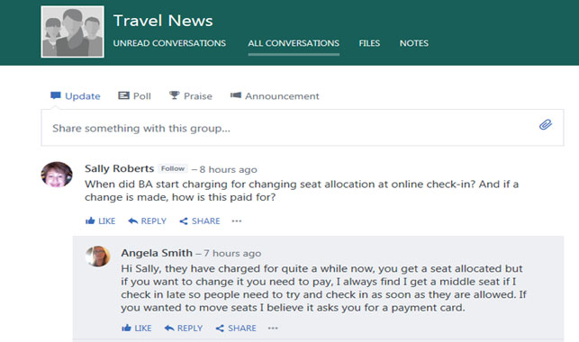
Carillion and Yammer

Slide 12
Thank you
Webinar: Does social media have a place in business travel?
Our Panel
Angela Smith
Carillion
Adam Knights
ATPI
Mark Frary
Business Travel iQ
See more at www.businesstravel-iq.com

Slide 13
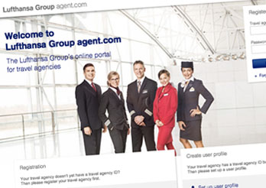
Our next webinar
How TMCs are dealing (or not) with Lufthansa’s DCC
Friday 29 April at 11am

