Slide 1




Welcome
Webinar: Open booking: beyond the hype
Our Panel
Herman van Waveren
Concur
Ian Ferguson
Business Travel Direct
Robert Daykin
Corporate Travel Partners
If you have a question for our panel…
Tweet: @BizTraveliQ #btiqlive
Or ensure this symbol is blue and fill the box to the right of your screen

Slide 2
Direct booking is happening
Hotel leakage exceeds 60% in Europe and 40% in North America
Source: CWT Travel Management Institute

Slide 3
Booking direct booking breakdown
Air = 24%
Hotel = 63%
Car = 37%

Slide 4
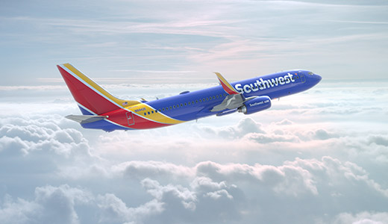
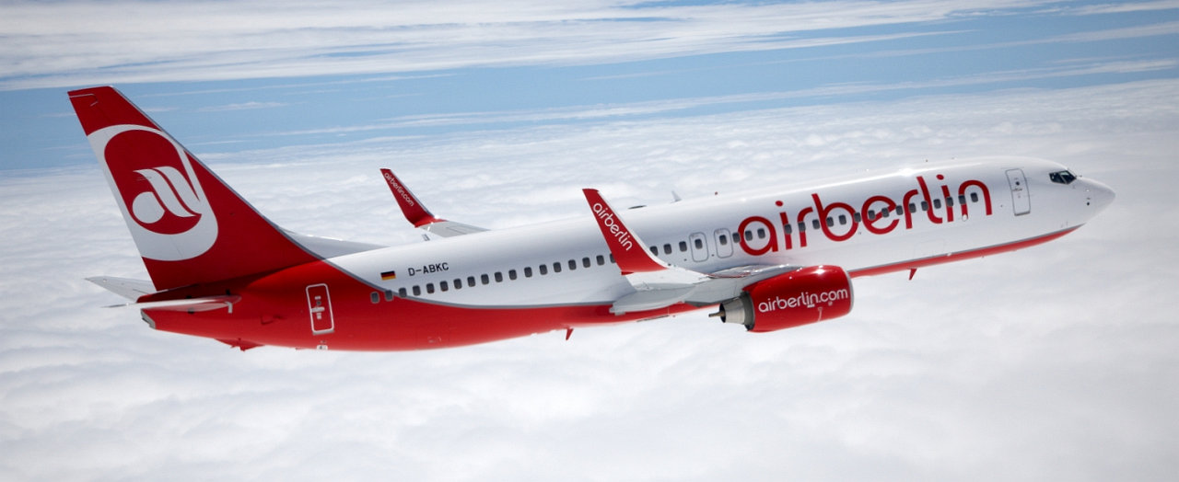
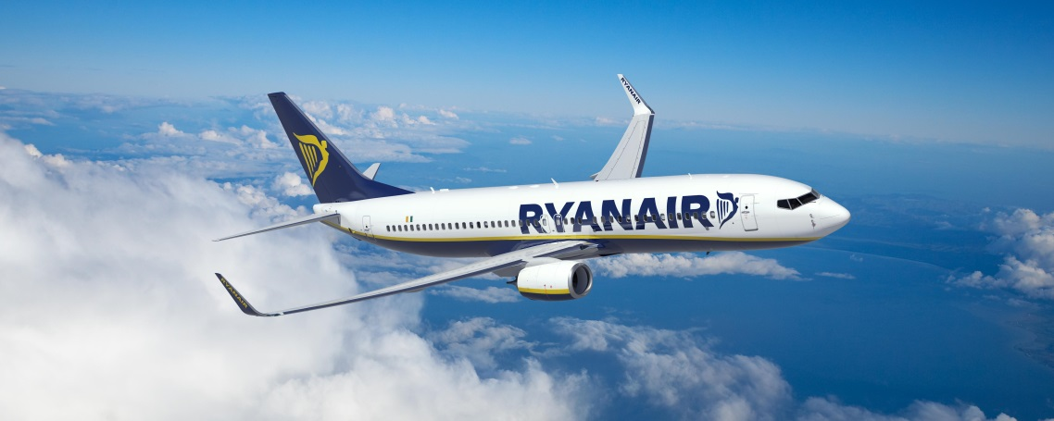






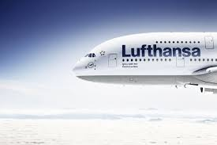
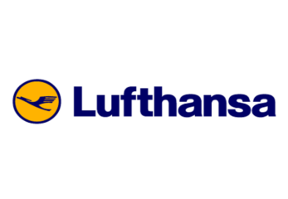

Suppliers incentivising direct booking
Started with low-cost carriers…
Evolving with sharing economy players…
Expanding to multi-national suppliers
€16 Fee for GDS

Slide 5
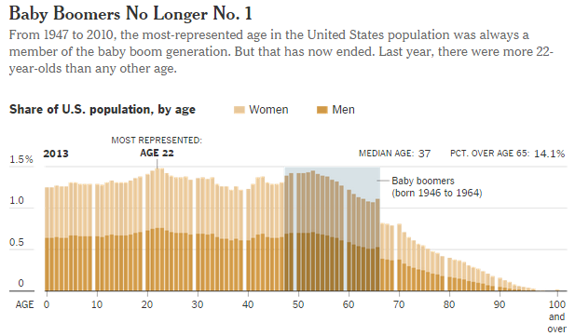
Impact of millennials
Largest age group in the US workforce is now 24-26 years old*
*NYT: Younger Turn for a Graying Nation 5/23/2014

Slide 6



Repercussions of direct spend
Visibility, reporting and policy enforcement
Duty of care, data and increased liability
Data to negotiate/sustain discounts
Savings from unused discounts

Slide 7
Direct booking hotel spend 2015
 | Approved Spend $ | Blind Spend $ | Blind % | If discount missed is 10%?
IHG | $2,239,000 | $1,025,000 | 46% | $102,500
Marriott | $997,000 | $685,000 | 69% | $68,500
SPG | $441,000 | $396,000 | 90% | $39,600
Potential Savings |  |  |  | $210,600
Source: UK non-named business

Slide 8

Best practice consolidated programme
Savings
Leverage data
Safety
Duty of care
Service
Obtain discounts
Traveller notifications
Easy to book
Consolidate data through TMCs
Volume commitments
Policy adherence
Locate employees
Employee safety
Reduce potential liability

Slide 9

Notes:
Leakage happens within travel programmes today and has done for many years
When we called it leakage, we had sensible and non-emotive conversations about how to address it
When we call it open-bookings, it sends the wrong message
At Business Travel Direct we recognised the growing unease that our customers faced over un-managed bookings
We decided to tackle this situation head on and embarked on a journey of learning and investment over the last 2 years to create an ecosystem that could help our customers understand, manage and give insights into what was happening
BUT….

Slide 10

Notes:
We are not encouraging people to press the anarchy button!!!
We don’t condone booking outside of the programme, the tools that we have deployed are not encouraging people to book off programme, they are assisting the corporations and buyers to identify, track and trend when it does!!

Slide 11




Transparent and accurate data
Tracking and safety
Knowledge and expertise
Appropriate content and pricing
Notes:
Critically, it’s about taking this additional information and bringing it back to the core values of a managed travel programme.
1 – Transparency and accuracy of data – link to compliance
2 – Tracking and safety – link to duty of care
3 – Knowledge and expertise – link to compliance and spend management
4 – Content and pricing – link to compliance and spend management
This will give us the critical insights to determine why people book off-programme, are they getting a better experience and saving the company money, if so how can it be incorporated back into the programme and that valuable data not be missed.
This does give us the opportunity to challenge pre-conceived ideas – share the insights or bust the myths!

Slide 12

Notes:
TMCs need to take a realistic view on our current industry landscape!!!
If you owned a coffee shop could you always say you sold the cheapest coffee?
There are outlets popping up on every corner from major companies to niche shops!
Loyalty cards try and force purchasing decisions
Coffee drinkers are targeted directly by chains
Binary branding drives people into a them vs us culture
There is immense choice
Coffee simply isn’t just plain old coffee any more and travel certainly isn’t the same travel we knew from before!!

Slide 13

Notes:
We all know the reasons why…
We’re in the middle of an established distribution war.
GDS providers no longer hold all the content cards
Content is massively fragmenting through ancillary services making shopping cumbersome across all key product areas
Increasingly blurred lines between corporate and leisure products
Hundreds of channels
Tens of thousands of apps!!!!
We’re glad we acted when we did !!!

Slide 14

Notes:
Business Travel Direct tool the decision that the answer wasn’t as simple as build or buy
We faced the dilemma that many other TMCs did to, if we simply built it ourselves how long would it take – with new content entrants coming into the market with increased frequency we’d still be building it now!!!!? Did we have the capability and who would ultimately end up footing the bill and would it drive us down a more retail based solution and commercials??!!
Could we find an off the shelf solution that did everything we needed – that was fit for purpose?
Ultimately neither option was right for us, we decided to partner with a progressive solutions provider, one who could give us a technology framework, filled with innovative solutions that we can use out of the box but also build, design and configure ourselves. This allowed us to think beyond the booking and ensure our internal expertise was placed on matching the solutions design with our customers travel programme goals.
Other TMCs have taken different approaches to tackle this problem, this happened to be the right route for us as we absolutely wanted to future-proof our business and our customers needs for what is already here and most certainly what is to come!!

Slide 15

Notes:
We started on a journey that led us to realise that collective identification and responsibility was key to reversing the spread of un-managed bookings and turn the un-managed back to managed again.

Slide 16

Concur TripLink
managed
un-managed
Risk
management and communication
platform
Concur Expense
itinerary
Spend consolidation for oversight & management
Business Travel Direct Mid-Office
Duty of care
Help when needed 24x7
Rate Auditing
Travel Programme Metrics
New components of our
evolving eco-system
Benchmarking Data
Notes:
This has allowed us to create an evolving eco-system of fit-for-purpose, future-proof solutions
As the technology continues to grow, we will grow with it – our ecosystem is being deployed at a measured rate, the speed of which will increase as more triplink and other connected partners join the Concur framework.
By utilising the key, interconnected solutions offered by Concur (alongside other innovative Business Travel Direct technologies) we are able to go beyond the first step of taking un-managed bookings to the itinerary and utilise the frameworks and products to track the traveller, consolidate the data across all our mid to back office systems, aggregate 3rd party data for benchmarking and provide more intuitive rate auditing capabilities.
Giving the ability for any booking to managed 24x7 by centralising the information even if it’s booked via an un-managed chanel is critical in our responsibilities to our customers

Slide 17

Un-managed is… manageable!
Notes:
This is about evolution not revolution…
In short, we’re trying to ensure we make un-managed travel, manageable again!

Slide 18



Why manage the travel category?

Slide 19



What is critical to success?

Slide 20
Thank you
Webinar: Open booking: beyond the hype
Our Panel
Herman van Waveren
Concur
Ian Ferguson
Business Travel Direct
Robert Daykin
Corporate Travel Partners
See more at www.businesstravel-iq.com

Slide 21

Our next webinar
Using social media in your travel programme
Friday 8 April at 11am

