Slide 1





Welcome
Webinar: Implementing an online booking tool
Our Panel
Angela Smith
Carillion plc
Clare Murphy
Bouda Consulting
Alex Paniagua
Egencia
If you have a question for our panel…
Tweet: @BizTraveliQ #btiqlive
Or ensure this symbol is blue and fill the box to the right of your screen

Slide 2




Collaborative implementation and change management
Week 1-2
Week 2-4
Week 5-6
Egencia Project Management: Planning, Coordination, Reporting, Communication
Kick Off
Egencia Workshops
Travel Policy | Change Management
Data Gathering
User Profiles | Negotiated Contracts
Approval Process | Payment means
Execution
Site Setup | Profile Loading
Front- Mid- and Back-office Setup
Supplier Contracts Loading
Testing
Communications
Training
Change Management
Launch
Travel Manager
Human Resources
Communication
Traveler/Arranger
IT
Manages Project on client side
Facilitates local communication
Shares travel program requirements
Shares profile list
Consulted for Change Management
Participates with Internal Communications
1-hour training
Participates in training
Onsite or online
Receives communications
Standard firewall check

Slide 3
Communication plan schedule
Phase | Communication | Resource for Communication | Audience | Date
Business official comms | Welcome Aboard Egencia - Announcement of Egencia as new appointed TMC Introduce the coming of Egencia, next steps, launch date and where to look out for upcoming information | Email / Internal Newsletter / Travel Intranet | Company level | 4 weeks before launch
Training | Welcome Aboard Egencia - Training Provide details on training sessions including what will be covered, dates and times and how to register. | Email / MS Word/ Powerpoint Intranet, Email, Shared Drive | Travellers Arrangers Approvers | 2 weeks before launch
Training (reminder) | Preparing for Take off - Training Update Reminder Training/ Engagement Sessions Email sent to invite Travellers to update profiles (if applicable) User Guide resource signed off and made available (intranet/Egencia website) | Email Presentation/ Webinar Intranet, Email, Shared Drive | Travellers Arrangers Approvers | 1 week before launch
Roadshow/Training | Introduction to Egencia and training on the website Tips on travel management | Face to face Webinar | Travellers Arrangers Approvers | Week before/of full launch
Launch | Cleared for Take Off - Confirmation of Launch Update on User Information, updating and checking profile information | Intranet News Item Email | Company level | Launch date
Post Go Live | Reaching Cruising Altitude with Egencia: Since some travelers will not take action until they have to book, this e-mail will remind travelers how to set up their profile, log-in and go for more information (such as your company intranet) | Email | Company level | 2 weeks after launch

Slide 4


Delivering savings in travel costs, plus time and fees
25%
18%
82%
75%
Non-Egencia
Clients
Online Adoption – Guaranteed!
We increase your online usage rate to 70% in 6 months. If we fail to do so, we will pay back the transaction fee price difference.

Slide 5
Delivering value to all your company’s stakeholders
Travellers
on the Road
Travellers and Arrangers
Travel
Managers
Finance and Procurement
24x7x365 Service and Emergency Support
Mobile ‘On the Go’ Services
Experienced Travel Consultant Support Team
Personalised, Easy to use Online Booking Tool
Choice with Access to Full Content
Strategy and Relationship Management
Consolidated Reporting
Traveller Tracking and Security
Lower agency transaction fees
Deliver Cost Savings on Travel
Automated Processes
Technology | Customer Service | Account Management

Slide 6
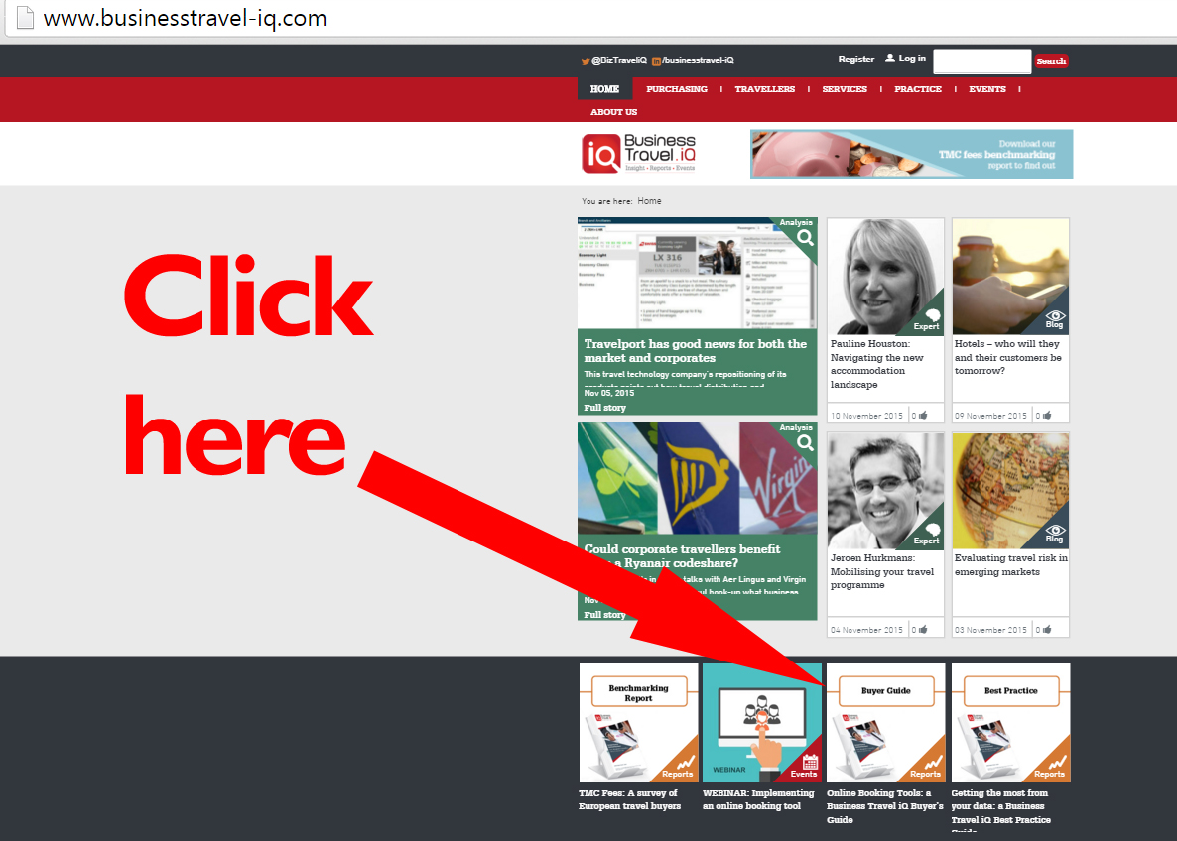
Getting the Buyer’s Guide

Slide 7
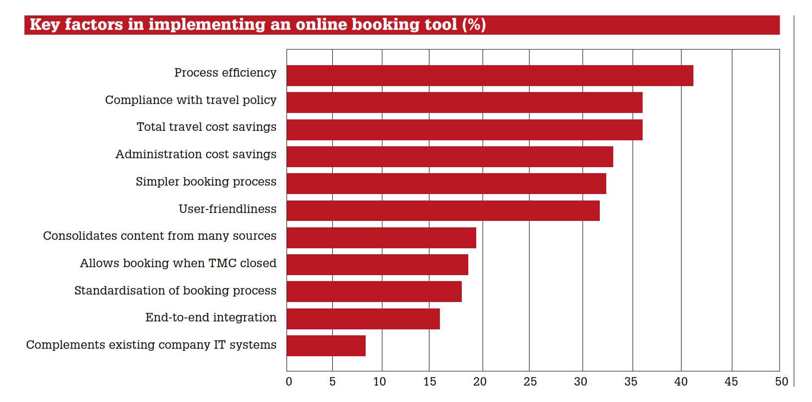
Why implement an online booking tool?

Slide 8
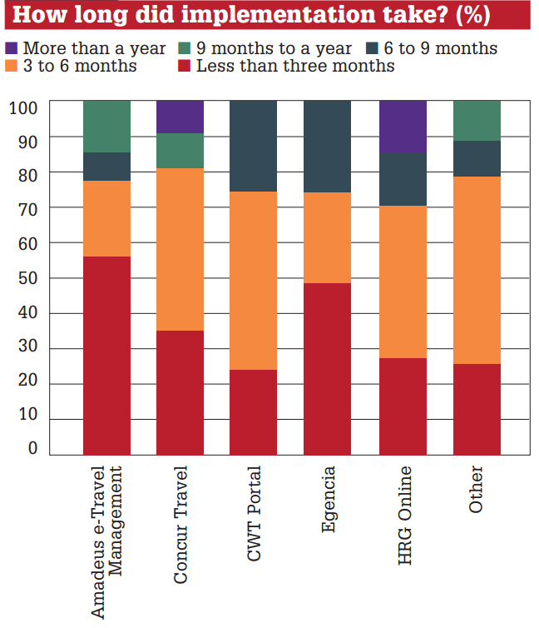
Time to implement

Slide 9
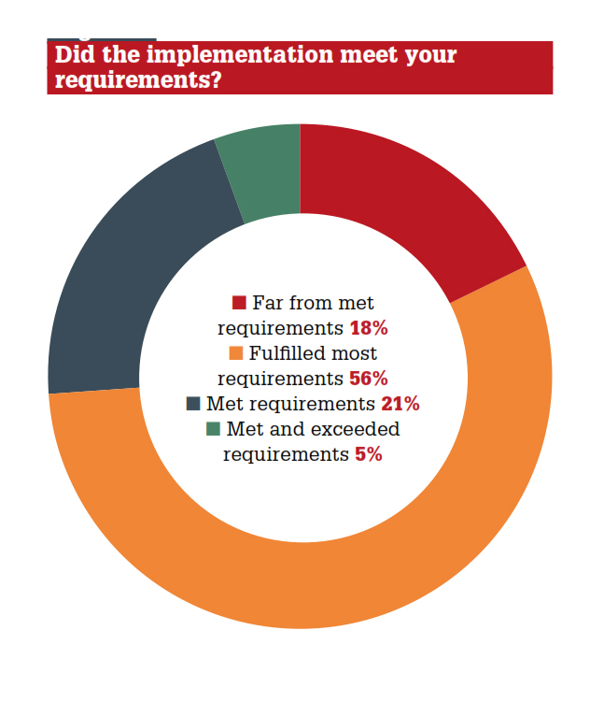
Did implementation meet requirements?

Slide 10
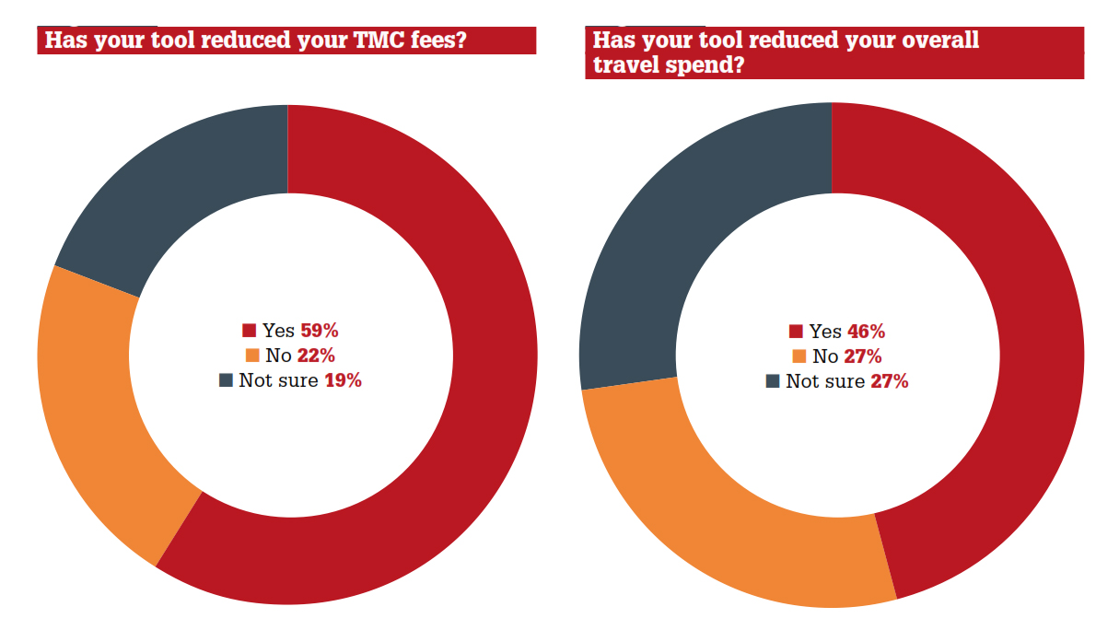
Reducing spend

Slide 11
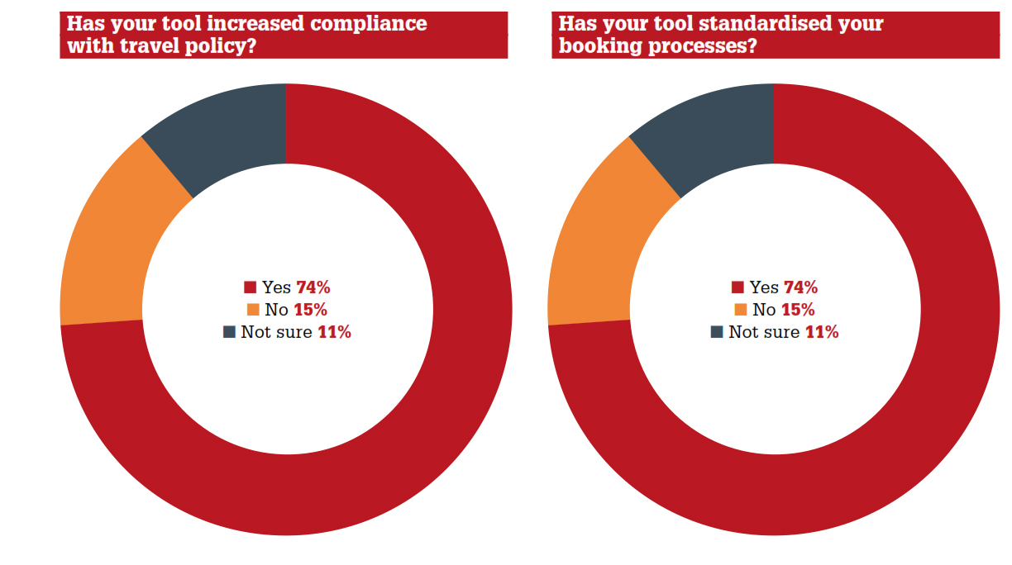
Other benefits of implementation

Slide 12
Thank you
Webinar: Implementing an online booking tool
Our Panel
Angela Smith
Carillion plc
Clare Murphy
Bouda Consulting
Alex Paniagua
Egencia
Download the full report at www.businesstravel-iq.com

