Slide 1
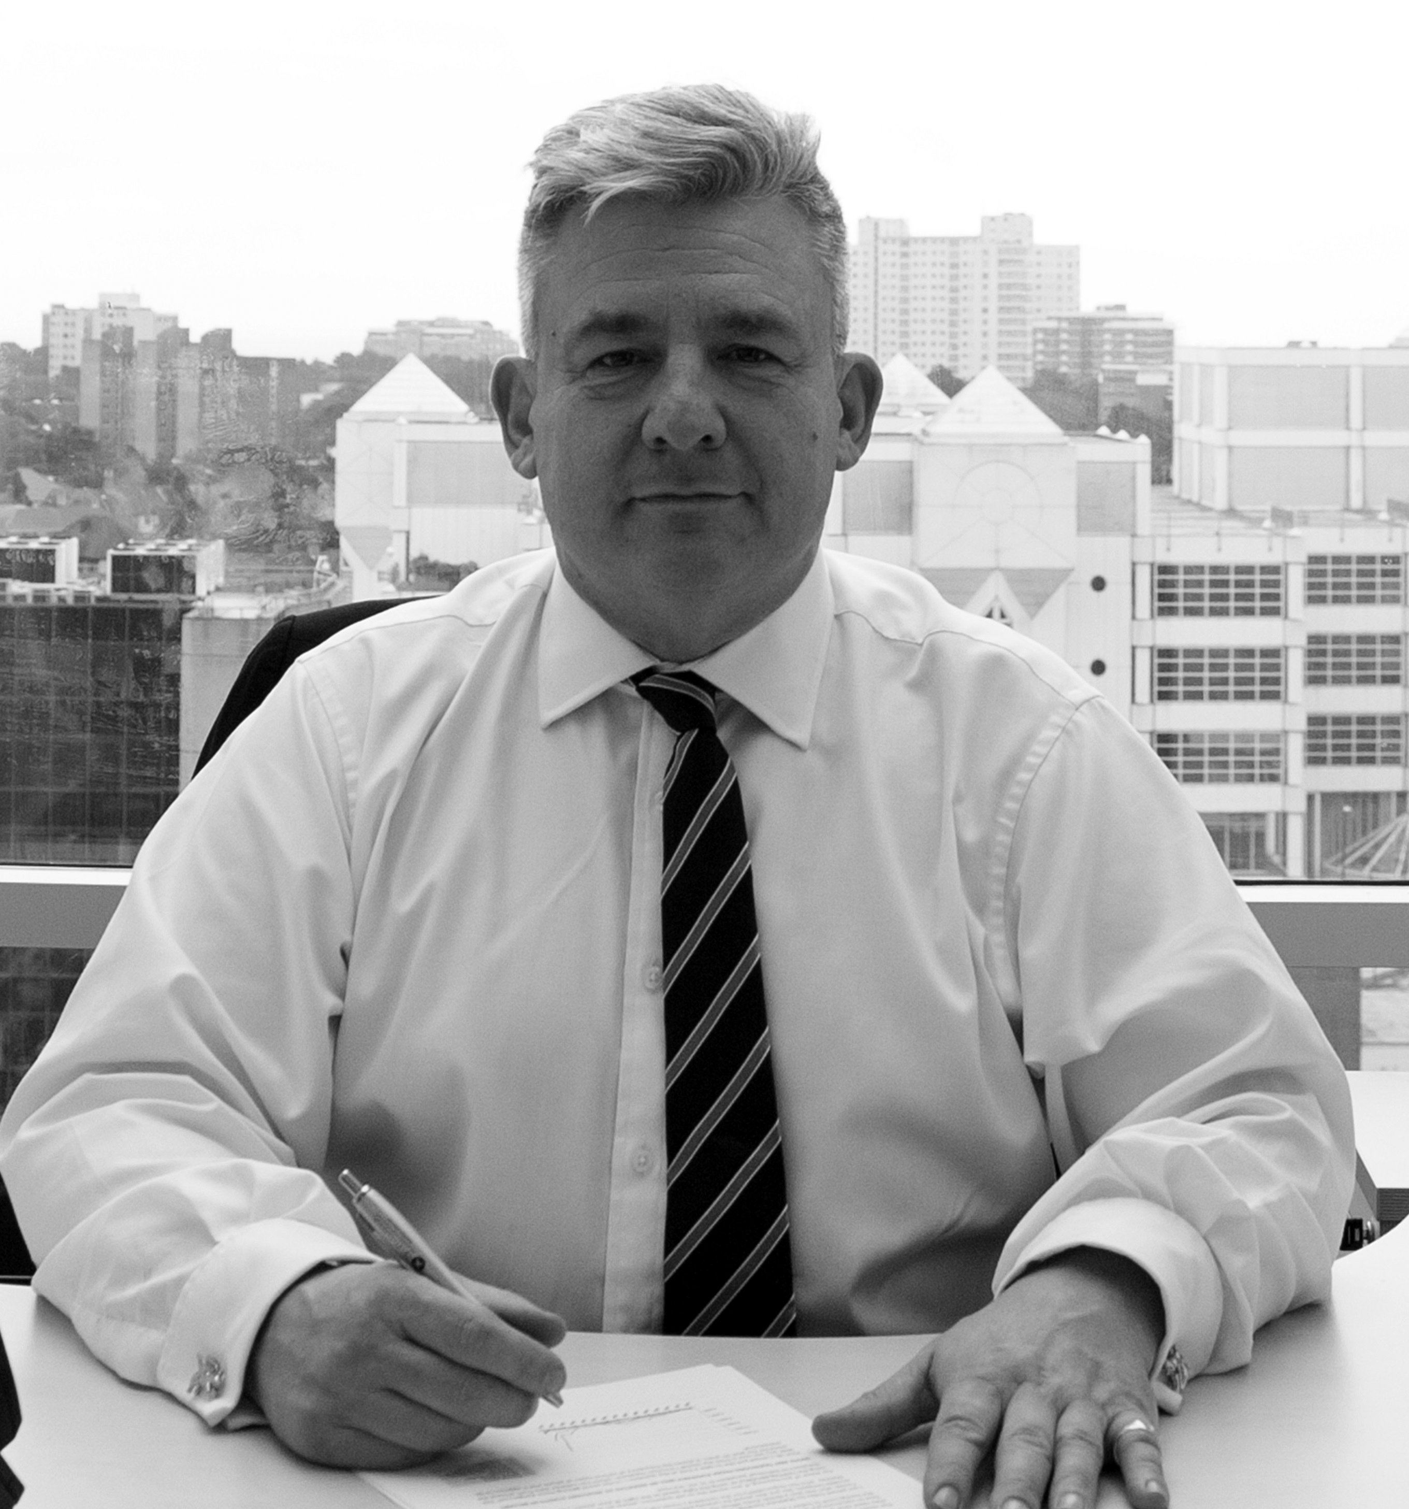
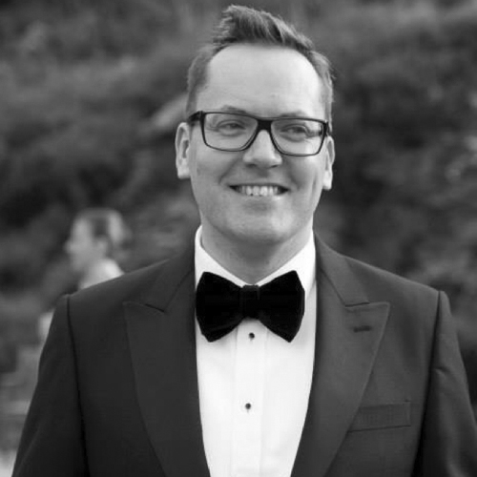
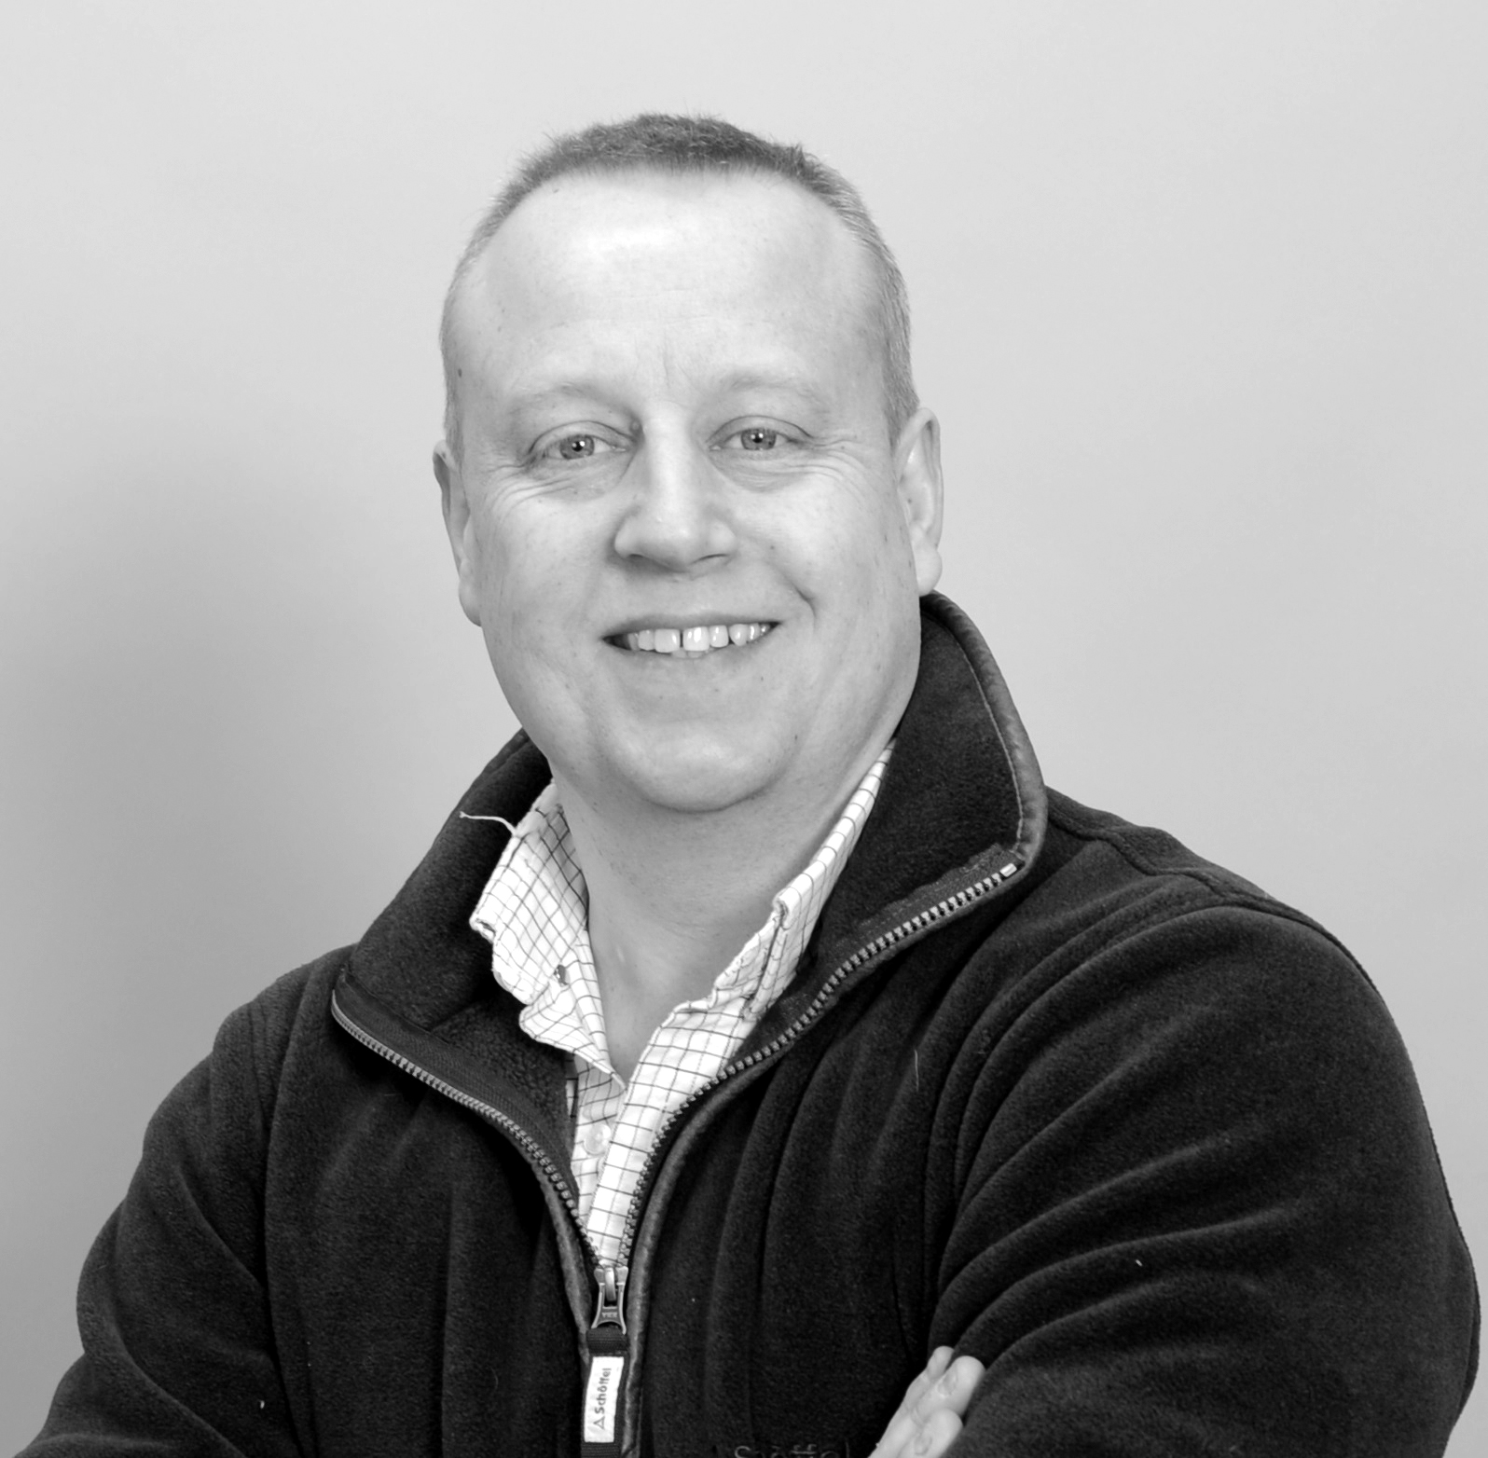

Welcome
Webinar: Managing the next Brussels
Our Panel
Matthew Harding
Drum Cussac
Calum McDougall
Reed & Mackay
Bob Thompson
Drum Cussac
If you have a question for our panel…
Tweet: @BizTraveliQ #btiqlive
Or ensure this symbol is blue and fill the box to the right of your screen

Slide 2
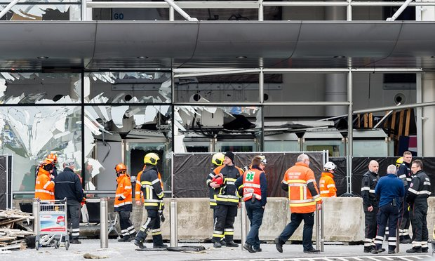
Practical Recommendations

Slide 3
Incident stages
Normal business travel
(pre-event)
Recovery / evacuation
(5hrs + post incident)
Incident
Immediate
post incident response
(+1hr – 5hrs)

Slide 4
Normal business travel (pre-event)
Robust traveller location awareness
Situationally aware travellers
Informed travellers
Resilient incident management procedures

Slide 5
Incident
Run
Hide
Tell
Decide > React > Report
Beware of secondary devices / attacks
Robust information transfer
Account for personnel

Slide 6
Immediate post incident response
(+1hr – 5hrs)
Continued information flow and situational awareness
Incident management procedures for unaccounted staff
Traveller - self triage - check-in
Medical / HR response

Slide 7
Recovery / evacuation
(5hrs+ post incident)
Travel contingency plans
Evacuation policy
Robust medical evacuation procedures
Peripheral support for those not directly involved

Slide 8
Brussels – case study
Incident Category 5 – Highest Level
7.22am UK time internal communications and action plan initiated followed by a targeted alert to all travellers in the vicinity. (Twitter/email/client portal)
Follow up external communications were sent out.
11.16am UK time all clients were accounted for. Downgraded to penultimate category level 4.
12.45pm UK time an information bulleting was shared with clients.
Alert regarding heightened security at other international locations shared.
Post incident de-brief by R&M Operations Director and incident report issued.
Several update alerts to client-base in the days that follow.
As soon as it appeared on media channels, before we knew the full scale of casualties, the Incident Management Unit resource was increased
52 travellers from 23 different companies were in Brussels at the time of the incident
The IMU* communicated with all clients and travellers by sending alerts as well as by phone for the clients affected
IMU* reported to travel managers which travellers we had been able to contact and which had not responded
Challenges: Early in the morning before the business day in the UK – not all travel managers responded to email or had a mobile telephone number available. Some were on leave with no real deputy.
Some traveller profiles did not have mobile telephones present.

Slide 9
Considerations
Incident governance structure in a crisis
Liaison with a risk management specialist
Evacuation planning

Slide 10
Pre-travel
  Key consideration: ‘Quality over quantity is key for travel and destination intelligence’
Are you providing the traveller with information pre-travel?
Are you making travellers aware of changes to risks?
Are you keeping an audit trail of communication?

Slide 11
The corporate view
Appropriate duty of care
Safety and wellbeing of people
Mitigation of consequential risk/impact
Business continuity in a crisis
Business resilience
Disaster recovery and business continuity
Supply chain confidence (customers and suppliers)

Slide 12
Resilience best practice
Risk intelligence (threat and vulnerability)
Process, planning, infrastructure
Preparation
Response
Recovery and continuous improvement
Expert help – you need dedicated risk management and response resource

Slide 13
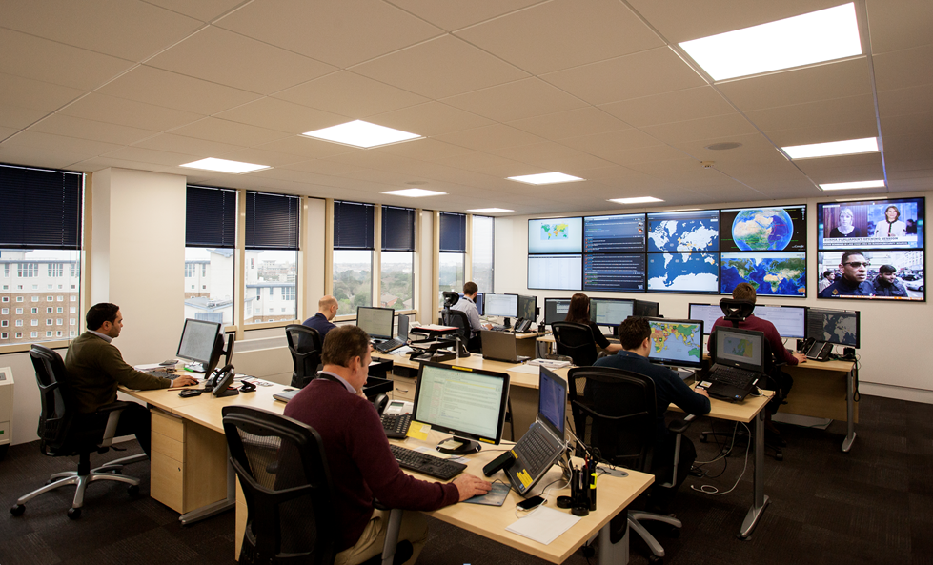

Slide 14
Thank you
Webinar: Managing the next Brussels
Our Panel
Matthew Harding
Drum Cussac
Calum McDougall
Reed & Mackay
Bob Thompson
Drum Cussac
See more at www.businesstravel-iq.com

Slide 15

Our next webinar
The dos and don’ts of RFPs
Friday 20 May, 11am

