Slide 1
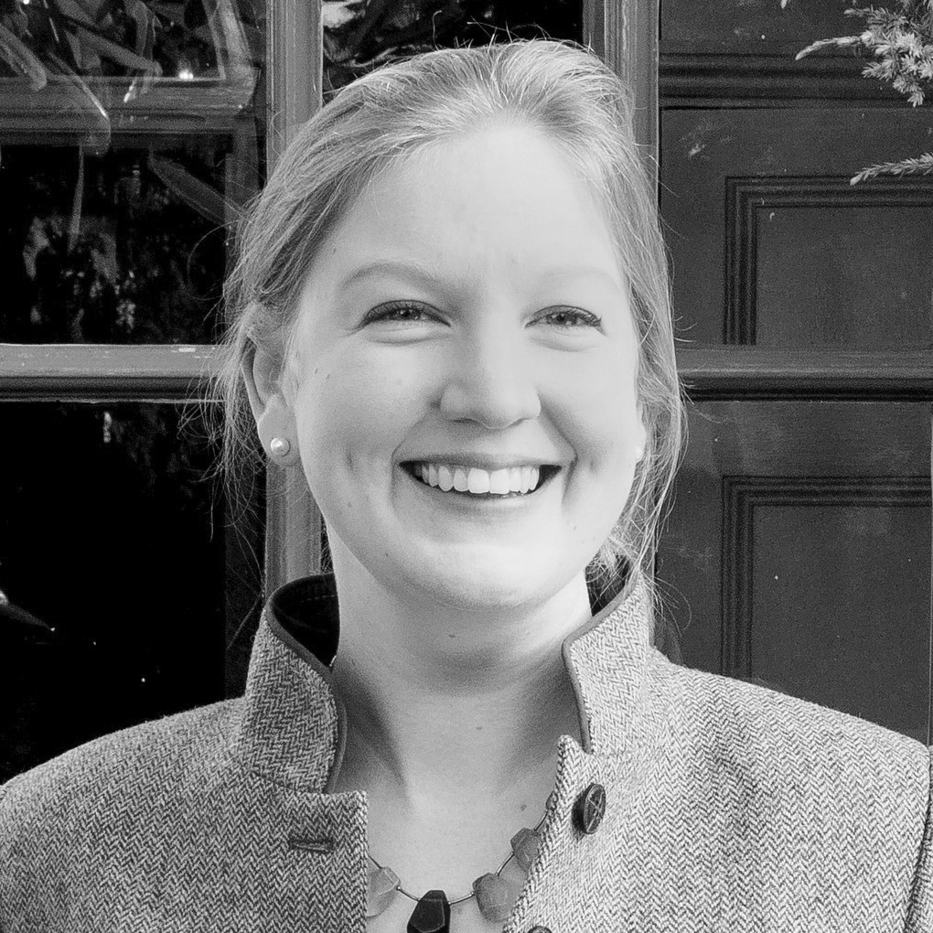
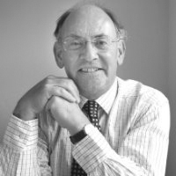
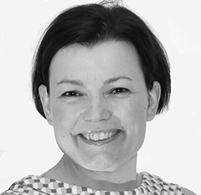

Welcome
Webinar: Choosing the right KPIs
Our Panel
Claudia Unger
Corporate travel knowledgist
Robert Daykin
CTP
Caroline Strachan
Festive Road
If you have a question for our panel…
Tweet: @BizTraveliQ #btiqlive
Or ensure this symbol is blue and fill the box to the right of your screen

Slide 2
KPIs vs KPMs
KPI: actionable and can be influenced
KPM: statistic or value over which you have no influence

Slide 3
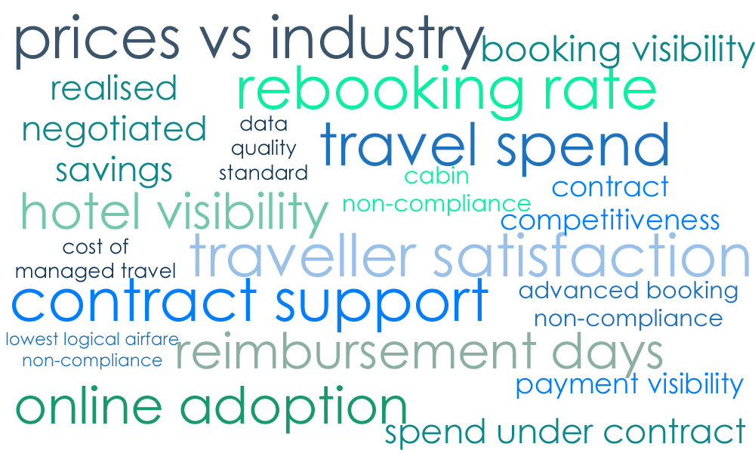
So many KPIs to choose from
Source: https://www.bcdtravel.com/wp-content/uploads/2014/04/BCD_Travel_KPI.pdf

Slide 4

  Traveller satisfaction

Slide 5

  Data quality

Slide 6
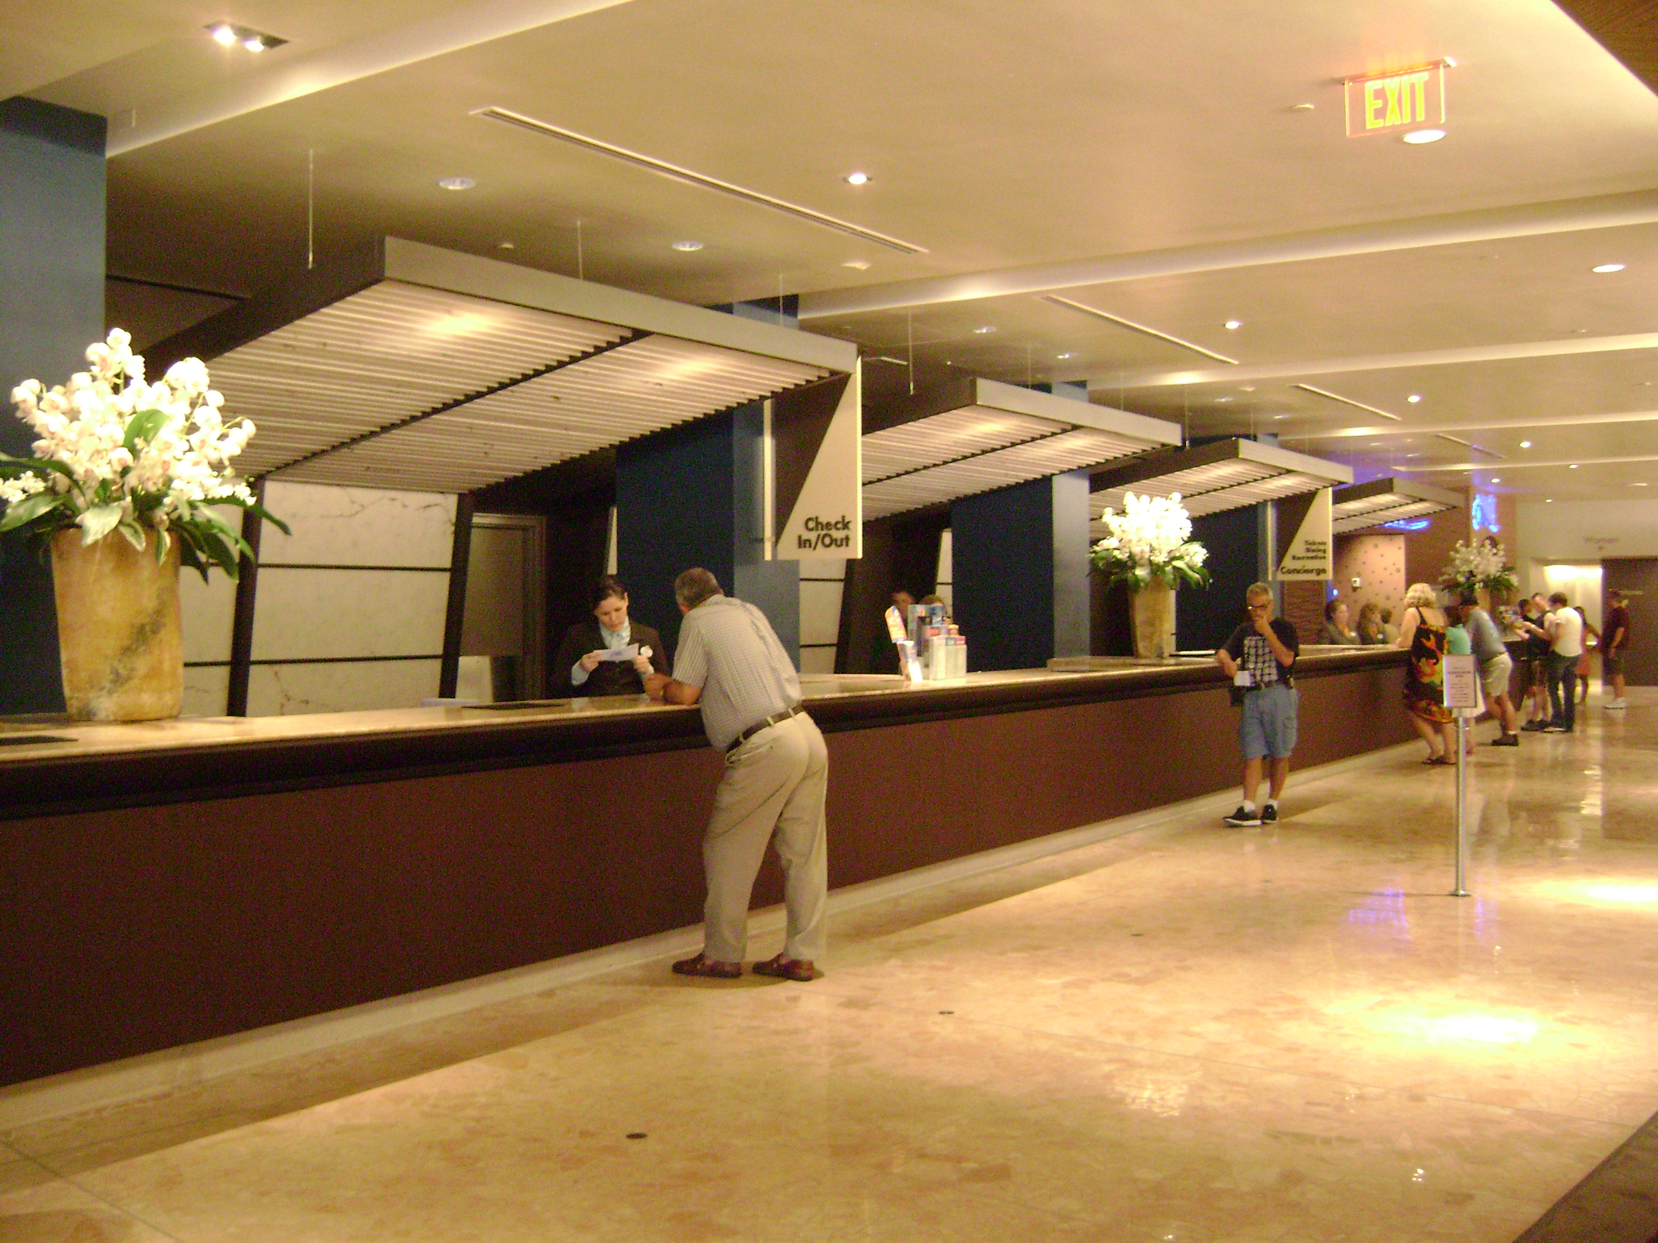
  Hotel visibility

Slide 7
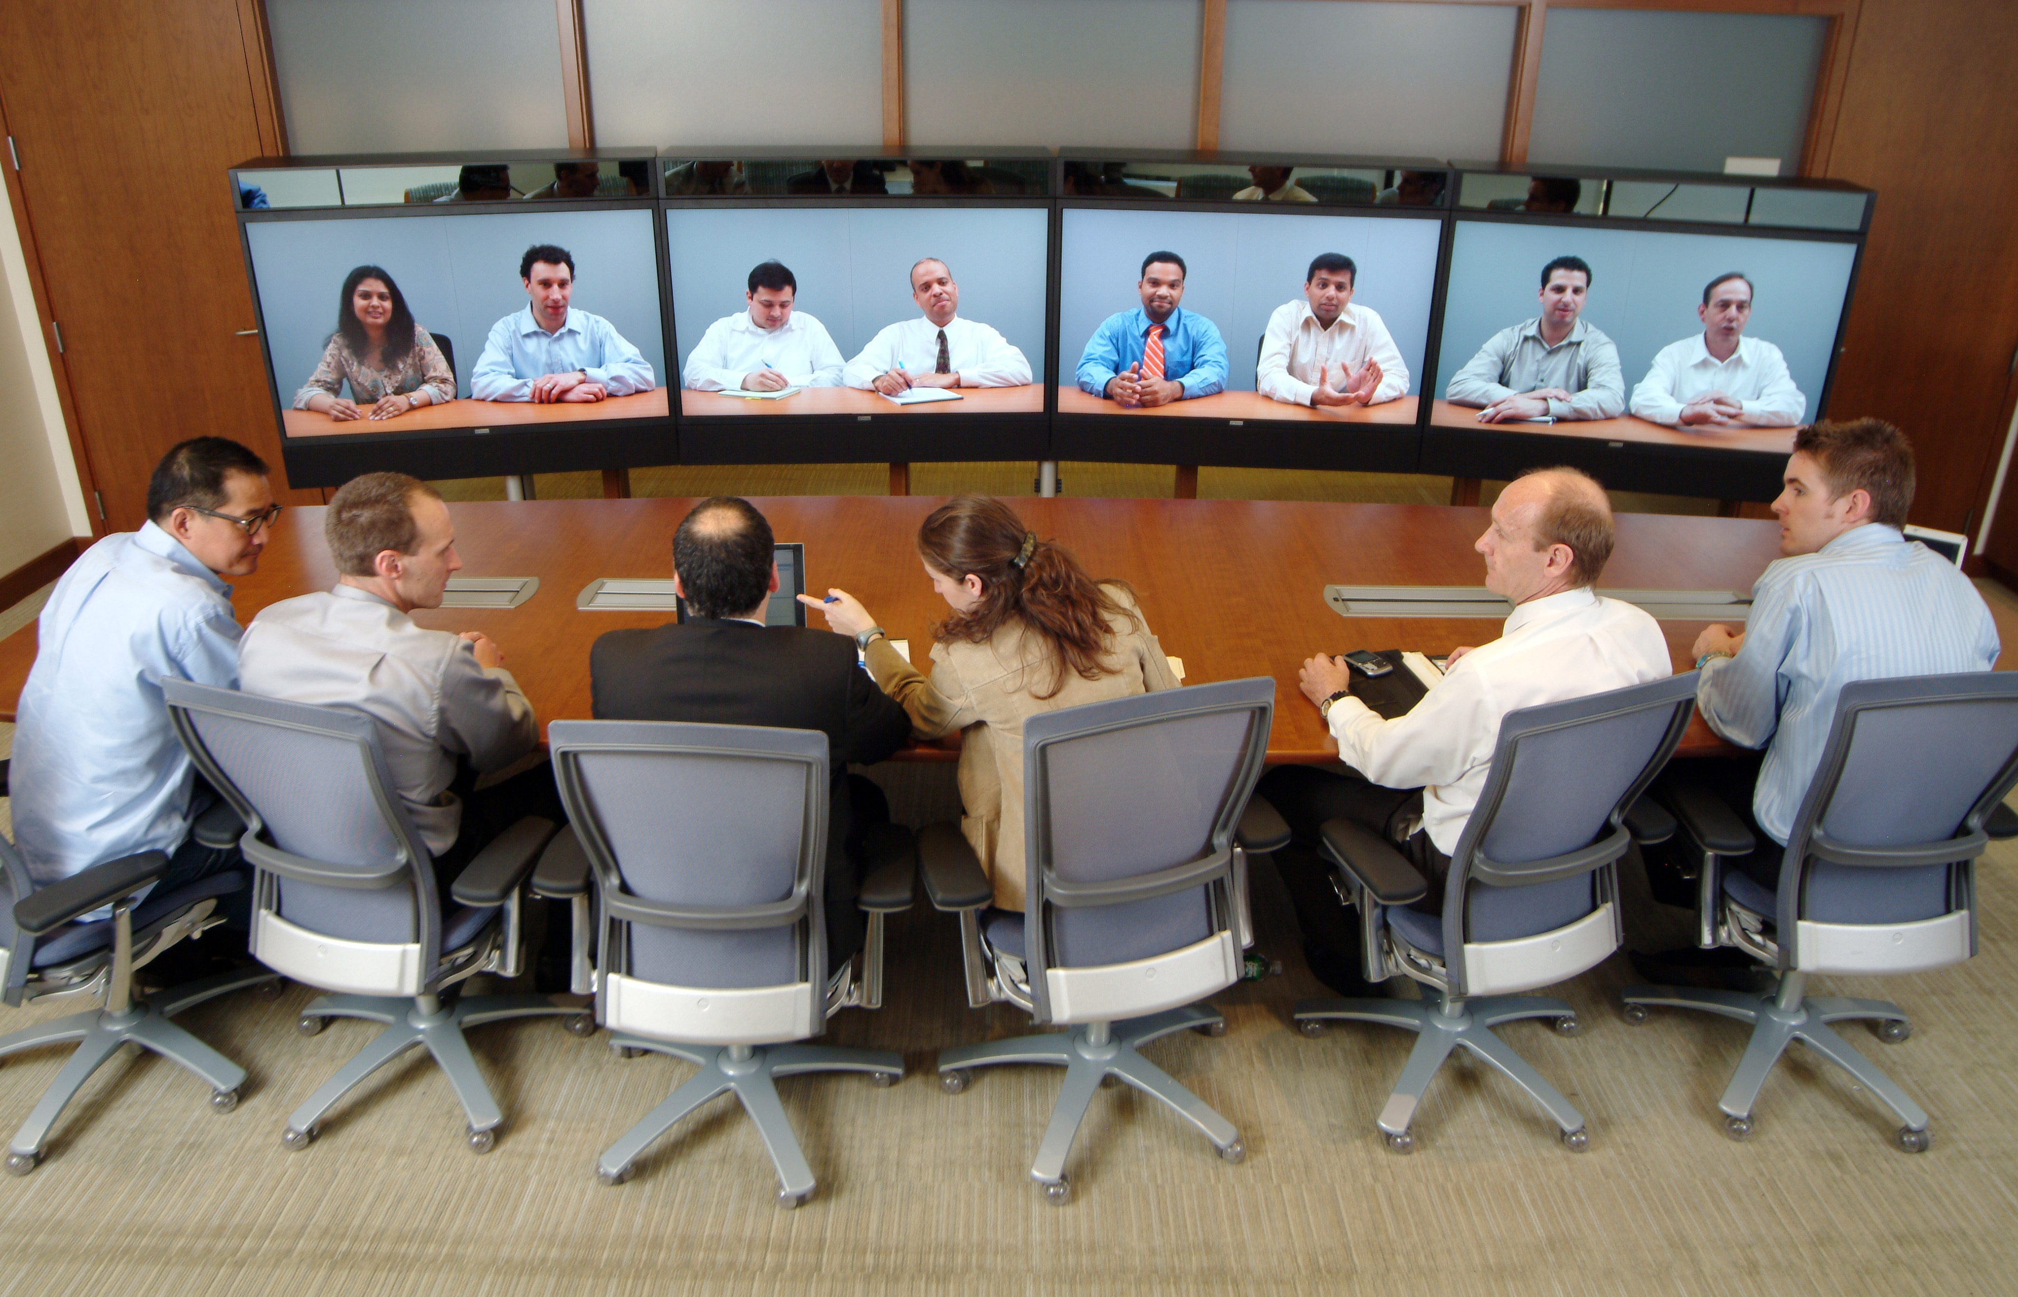
  Virtual meeting index

Slide 8

  Traveller well-being

Slide 9

  T&E spend vs revenue

Slide 10
Thank you
Webinar: Choosing the right KPIs
Our Panel
Claudia Unger
Corporate travel knowledgist
Robert Daykin
CTP
Caroline Strachan
Festive Road
See more at www.businesstravel-iq.com

