Slide 1
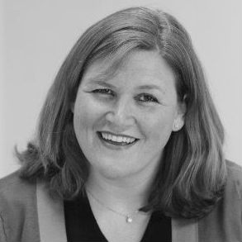
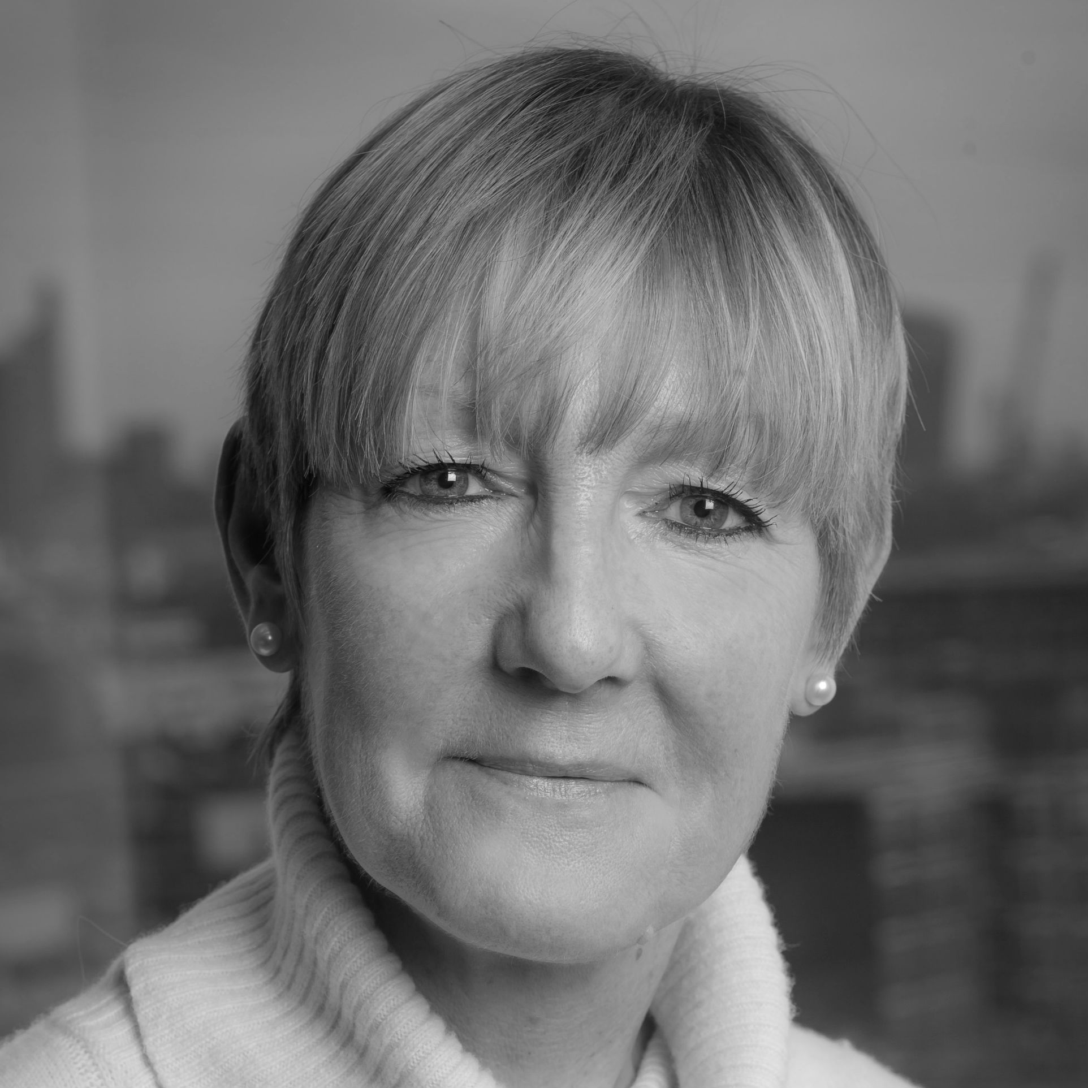
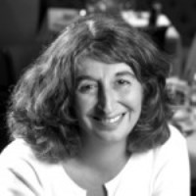
Welcome
Webinar: From theory to practice: how to set up a meetings programme
Our Panel
Samantha Van Leeuwen
PwC
Jean Squires
Lanyon
Betty Low
Business Travel iQ
If you have a question for our panel…
Tweet: @BizTraveliQ #btiqlive
Email: editorial@businesstravel-iq.com
Or ensure this symbol is blue and fill the box
to the right of your screen

Slide 2
Strategic Meetings Management
Provides visibility to all meetings and event spend
Identifies best practice, share knowledge and skills
Facilitates cost savings and risk mitigation
Ensures quality and consistency
Saves resource through efficiency and effectiveness
Provides the basis on which to leverage associated spend
Improves the experience for planners and attendees and securing the required outcomes

Slide 3
Be aware of the challenges
Stakeholder resistance
(internal / external)
Variable payment processes
Lack of senior level endorsement
Questionable ROI
No centralisation
Lack of resource
No ownership
No policy guidelines
No consistent approach
Little or no data
Cultural and contractual variations

Slide 4
Everyone faces objections
“Senior management doesn’t listen/doesn’t understand/isn’t interested”
“I don’t have any budget”
“I don’t have the data/I don’t know where to look for the data/suppliers can’t provide the data”
“I don’t have time to implement a big system”
“Today’s technology will be out of date tomorrow”
“This is just too complicated!”
“I don’t know where to start…”

Slide 5
So, where DO I start?
Network
- BTiQ, industry associations and events
Ask advice
Share experiences
Phone a friend?!

Slide 6
Identify your stakeholders
Policy makers
Suppliers
Users
Board members
Financial controller
Procurement
Agencies
Specialist providers
Hotels/venues
IT/AV
Internal departments
Sales and marketing
HR/training
Executive floor
Travel coordinators
PAs/Executive secretaries
Decision influencers
Security
Finance
HR

Slide 7
Find your champions
Senior sponsor
Board member(s)?
Financial controller?
Invest in getting the support you need from the very top – without it you can’t move forward
Experienced
Vocal
Influential
Travel coordinators/meeting planners
PAs/Executive secretaries
Single department of active users
Super users

Slide 8
PwC meeting and events objectives
To manage the procurement, leverage spend and benchmark cost and effectiveness of suppliers
To support the firm by developing best practice processes for meetings and events
Enhance control and visibility of meetings
Advise and manage contractual risk
Understand and manage CR implications within meetings/ venues

Slide 9
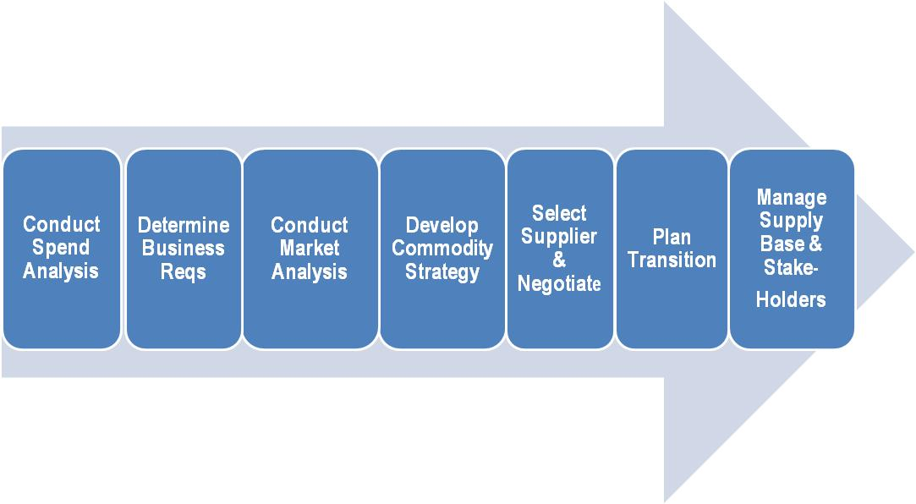
PwC strategic approach
Robust
MI
Manage
risk
Develop
strategy
Policy
Consolidate
savings
Effective
process
Compliancy
Relationships

Slide 10
Data
Stake-holders
Value for money
Process
Comms

Slide 11
Key learnings
Relationships are key to the success of a strategic meetings programme
But remember longevity of process, change and relationships don’t happen overnight!
Hold open and honest conversations
Value and terms are as important as rate
Be strategic but be realistic!
Good quality MI is critical

Slide 12
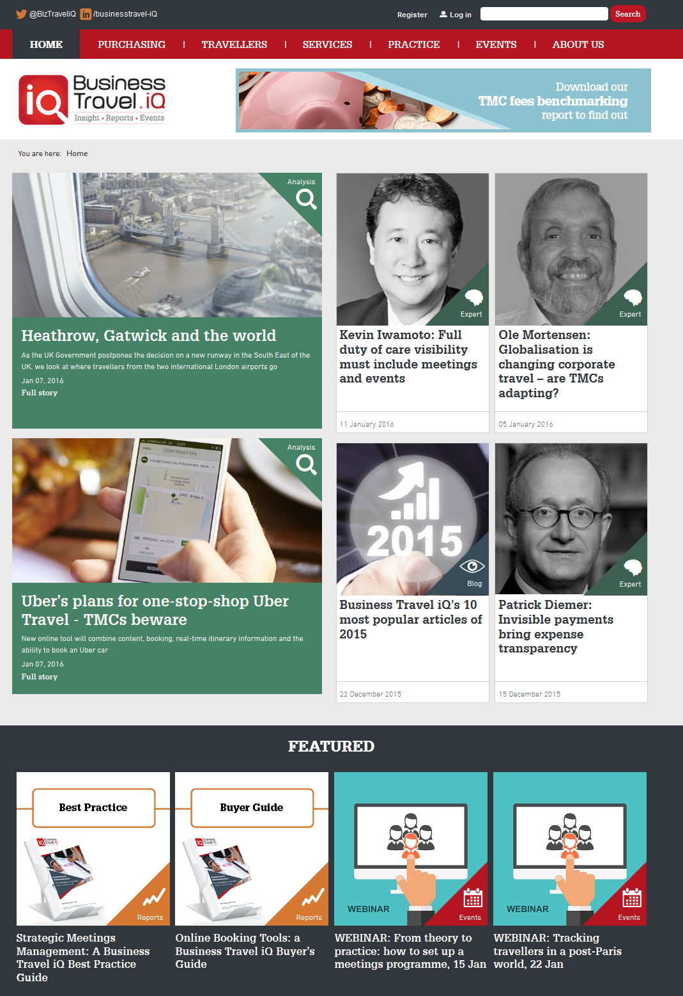
Thank you
Webinar: From theory to practice: how to set up a meetings programme
Our Panel
Samantha Van Leeuwen
PwC
Jean Squires
Lanyon
Betty Low
Business Travel iQ
Download the full report at www.businesstravel-iq.com or email editorial@businesstravel-iq.com for more information

