Slide 1




Welcome
Webinar: Distribution alternatives
Our Panel
z
Annicka Lofstrand
KDS
Karolien Priem & Marc Zuber
Nestle
Betty Low
Business Travel iQ
If you have a question for our panel…
Email: editorial@businesstravel-iq.com
Tweet: @BizTraveliQ #btiqlive
Or ensure this symbol is blue and fill the box
to the right of your screen

Slide 2

What’s driving distribution change?
Changing traveller behaviour
Merchandising
Technology
innovations
Economy and legislation
Cost
Differentiation
of services,
loyalty
Hyper-connected workforce want choice and convenience
Mobile apps, big data, sharing economy
Economic climate, manslaughter act, data privacy
Continued focus on driving down cost and margins

Slide 3
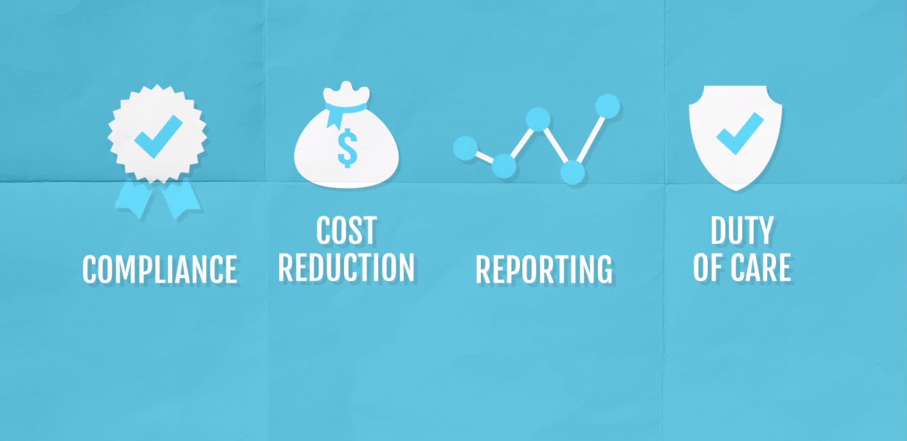





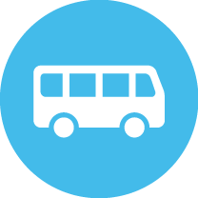

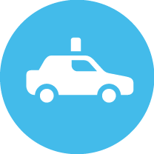


The impact on business value

Slide 4
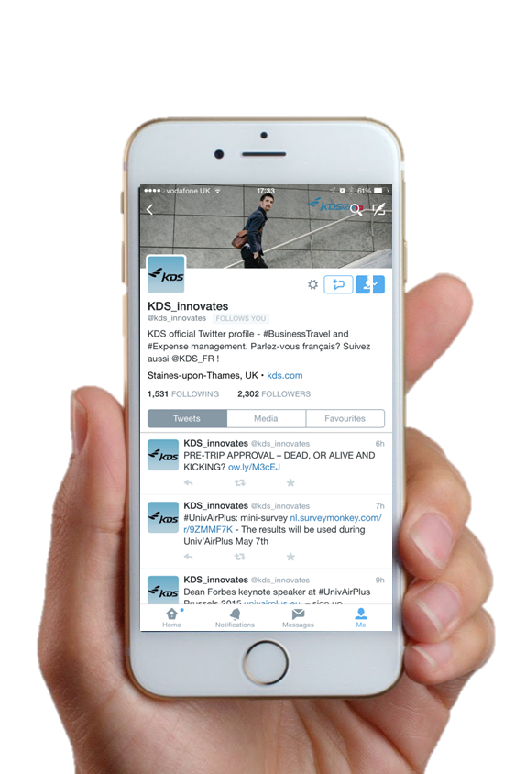
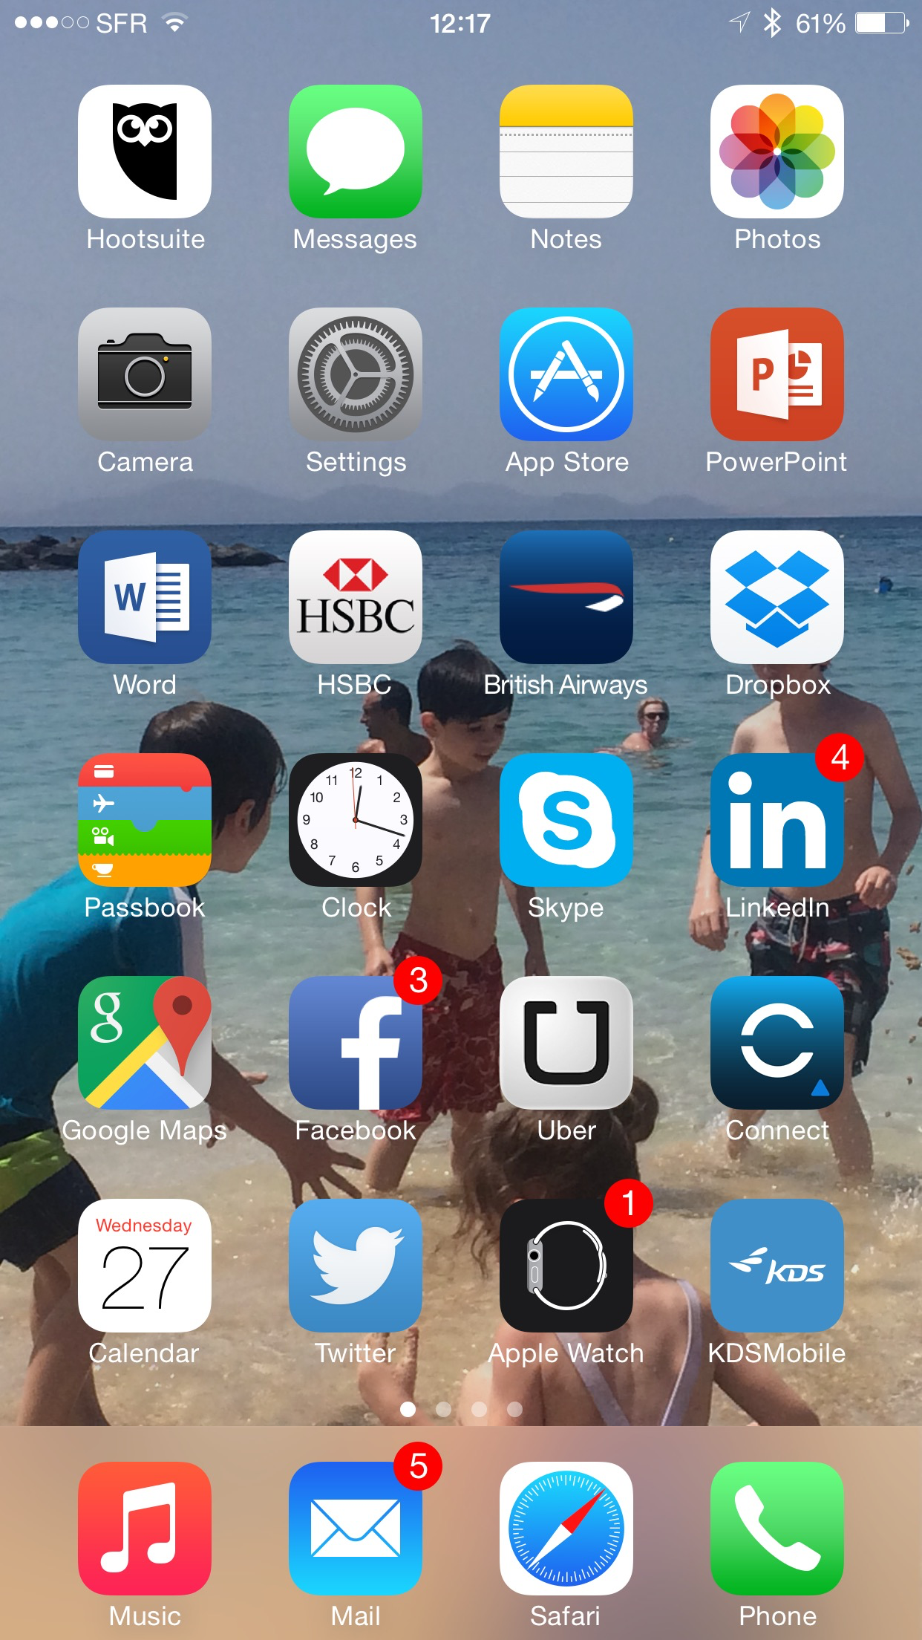












Cost, control and convenience
AND consumer, content and context

Slide 5

The path ahead
Standardisation vs individualism
Data
Mastering the user experience

Slide 6
Collaboration for a better experience
Technology is an enabler
Door to door experience
Balance business and users
Value through collaboration

Slide 7
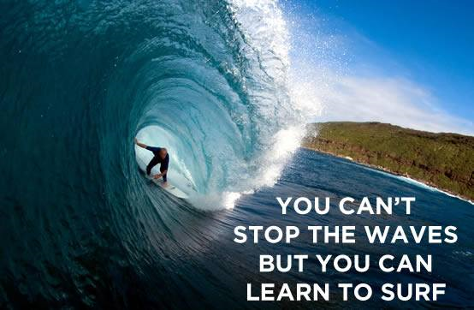
Distribution ‘disruption’ is a reality
Our choice
Ignore the distribution changes and get “hit” by the wave
Identify the opportunities and “ride” the wave

Slide 8
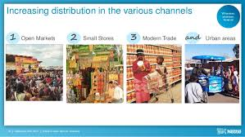
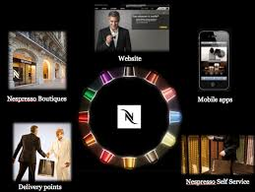

Distribution challenges are common among all industries
Being close to the “customer” is key!
Closed distribution channel

Slide 9
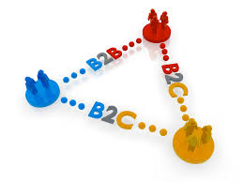
Travel manager/TMC as an intermediary
- need to add value in the distribution chain
Travel manager/
travel agency
Risk
Supplier support of B2B/B2C channels depends on our ability to create value for them
Risk
Supplier
Key to also think of the end user (i.e. traveller) when defining the appropriate distribution channel
Traveller

Slide 10
Why do travel managers (currently) want to control distribution channels
Cost concerns
  Transparency on options availability
  Policy compliance
  Lack of product/service differentiations drives this necessity
User acceptance concerns
  Process efficiency
  Right content
  One-stop-shop key to maintain travellers engaged with corporate travel programme
Direct Connect solutions do not address these needs

Slide 11
How could travel managers get ‘control’ over the distribution channels?
Differentiation of products/services
  Where possible, develop partnerships to develop differentiations of products/services
  NDC is going to be a major enabler for airline content
Selective content aggregation
  Define what level of aggregation is sufficient; “less is more”
Engage with Travellers
  Travellers have to understand the value for them of the corporate travel programme
  Showcase to your suppliers that you are influencing the decision process to incentivise them to distribute through your preferred channels
Accept selective Direct Connect solutions
  Be ready to deploy a controlled“direct connect” solution

Slide 12
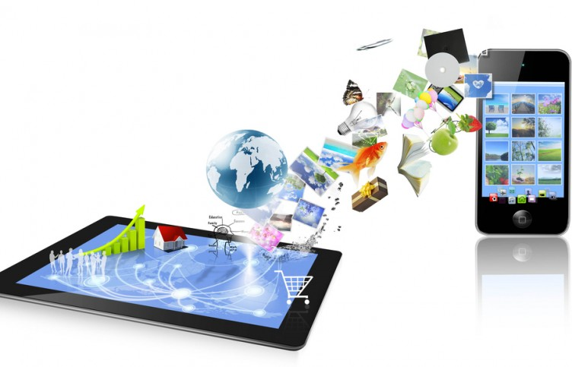
What should not interest the travel manager
The distribution technology is not a prime concern for travel managers
Technology is an important part of distribution but it is not the main concern/driver for travel managers

Slide 13
Thank you
Webinar: Distribution alternatives
Our Panel
z
Annicka Lofstrand
KDS
Karolien Priem & Marc Zuber
Nestle
Betty Low
Business Travel iQ
If you have a question for our panel…
Email: editorial@businesstravel-iq.com
Tweet: @BizTraveliQ #btiqlive
Or ensure this symbol is blue and fill the box
to the right of your screen

