Slide 1

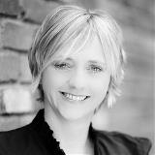
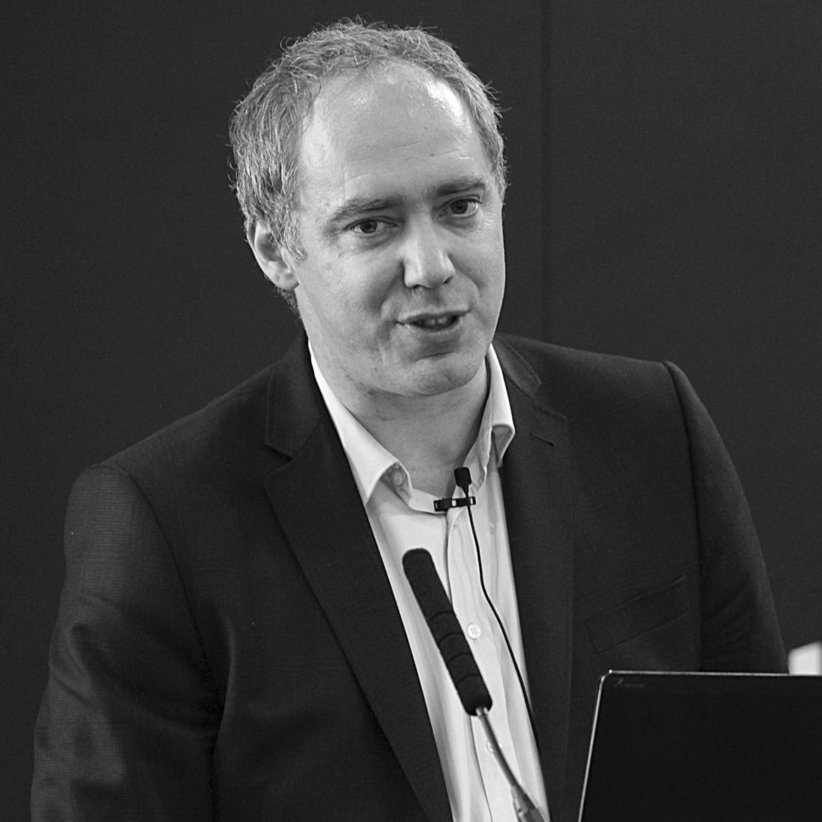

Welcome
Webinar: Getting the most from your data
Our Panel
Keesup Choe
PI
Johanne Young
Opteva
Mark Frary
BTiQ
If you have a question for our panel…
Tweet: @BizTraveliQ #btiqlive
Or ensure this symbol is blue and fill the box to the right of your screen

Slide 2
Video to play

Slide 3
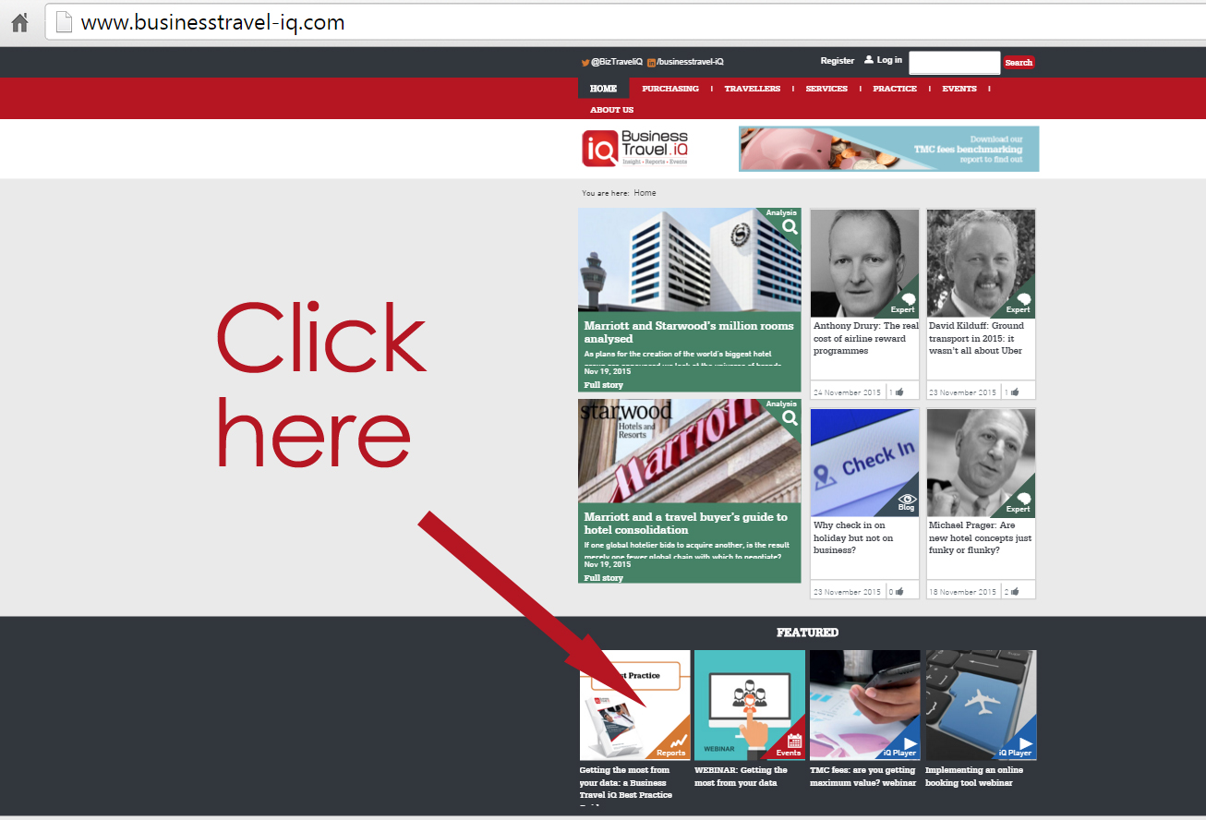
Getting the Data Best Practice Guide

Slide 4
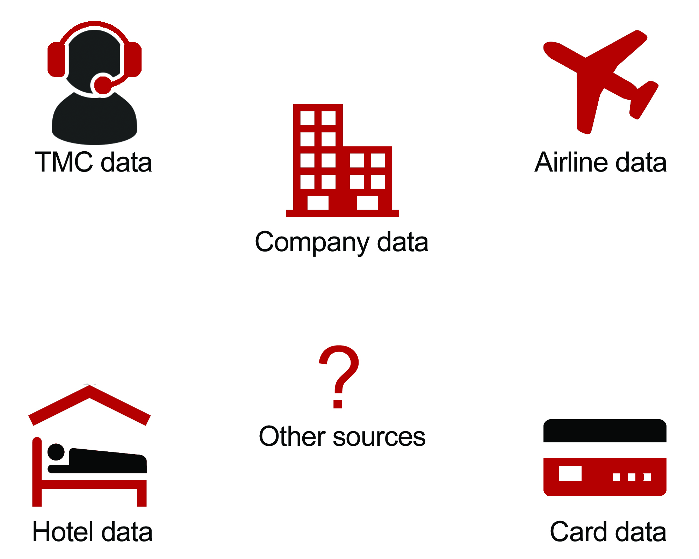
Sources of data

Slide 5
Typical reports
Top travellers
Top suppliers
Top city pairs
Exception reports
Beyond the obvious

Slide 6
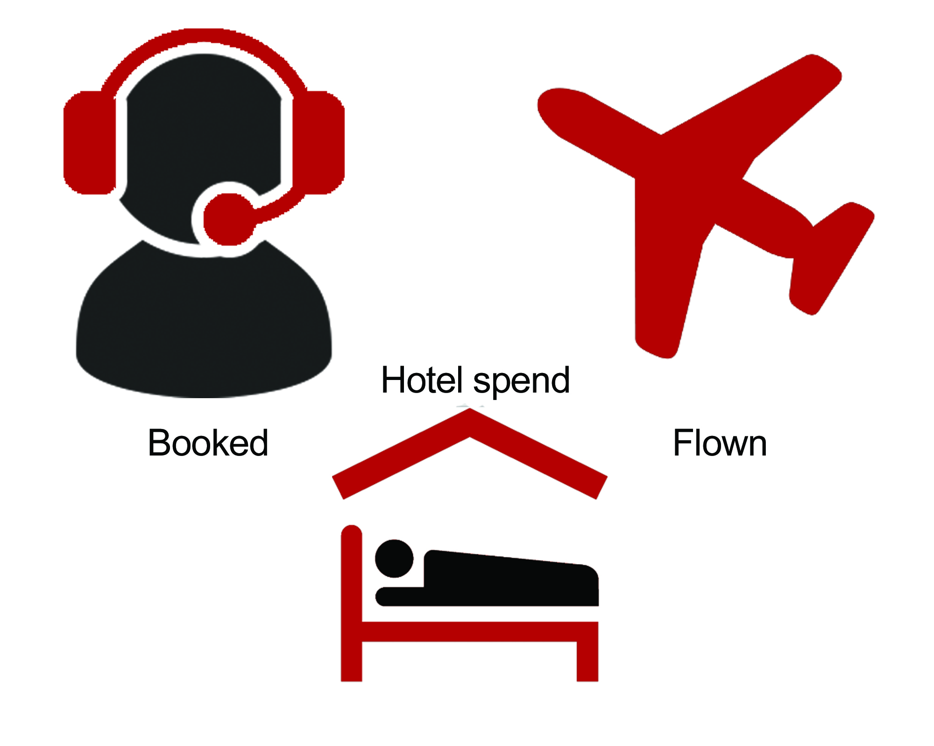
Booked vs spent

Slide 7

Why the ‘3 As’
Should Replace the
‘4 Vs’ of Big Data
Keesup Choe
PI

Slide 8

Popular press idea about ‘4 Vs’ of big data
Volume, velocity, variety, veracity

Slide 9
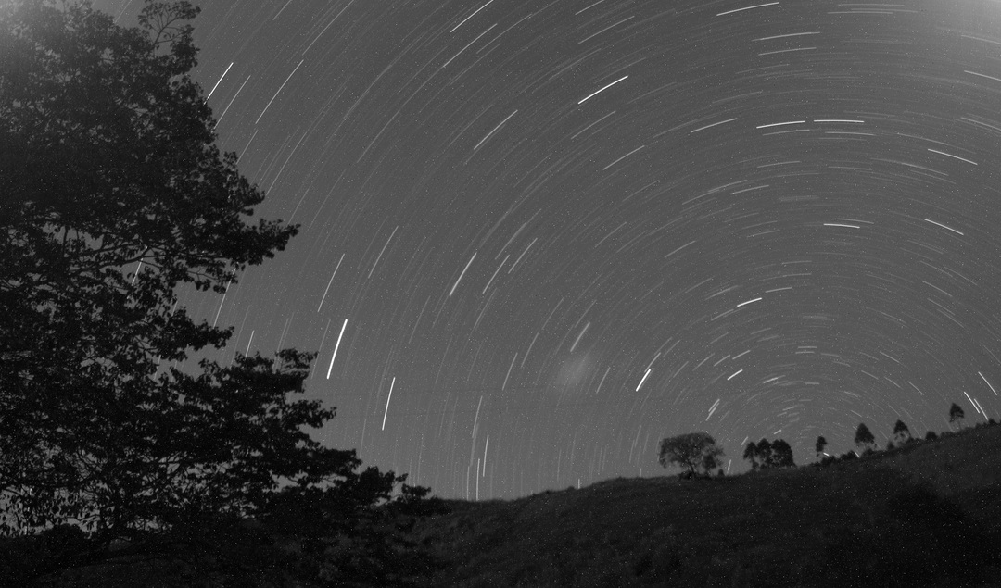

Data challenges keeping you awake at night..
Organisations are looking to understand what is driving traveller behaviour; they want
meaningful and actionable reporting, a complete picture of supplier spend and a holistic
view of trip level costs, connecting travel & expense data can help to achieve this
You can’t manage what you can’t see
You want to consolidate all relevant travel data from multiple sources such as TMCs, credit cards and internal systems and understand what you need to do to transform your programme

Slide 10


But actually only 3 are relevant:
Accuracy, Aggregation, Automation

Slide 11

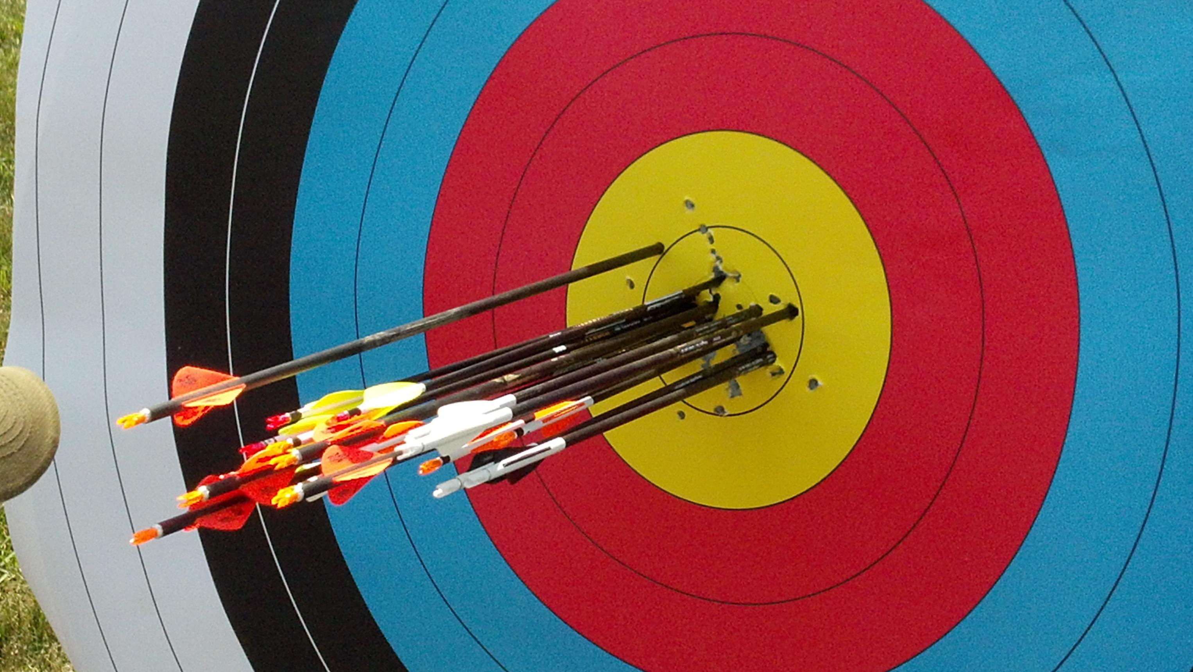
Accuracy
The root problem of wide data and integrating different sources is one of accuracy

Slide 12


Aggregation
Even if accurate, if the datasets are materially different, say in different languages, aggregation is a challenge

Slide 13
Automation
Without the automation capabilities of machine learning, decision making will be subject to unavoidable delays

Slide 14
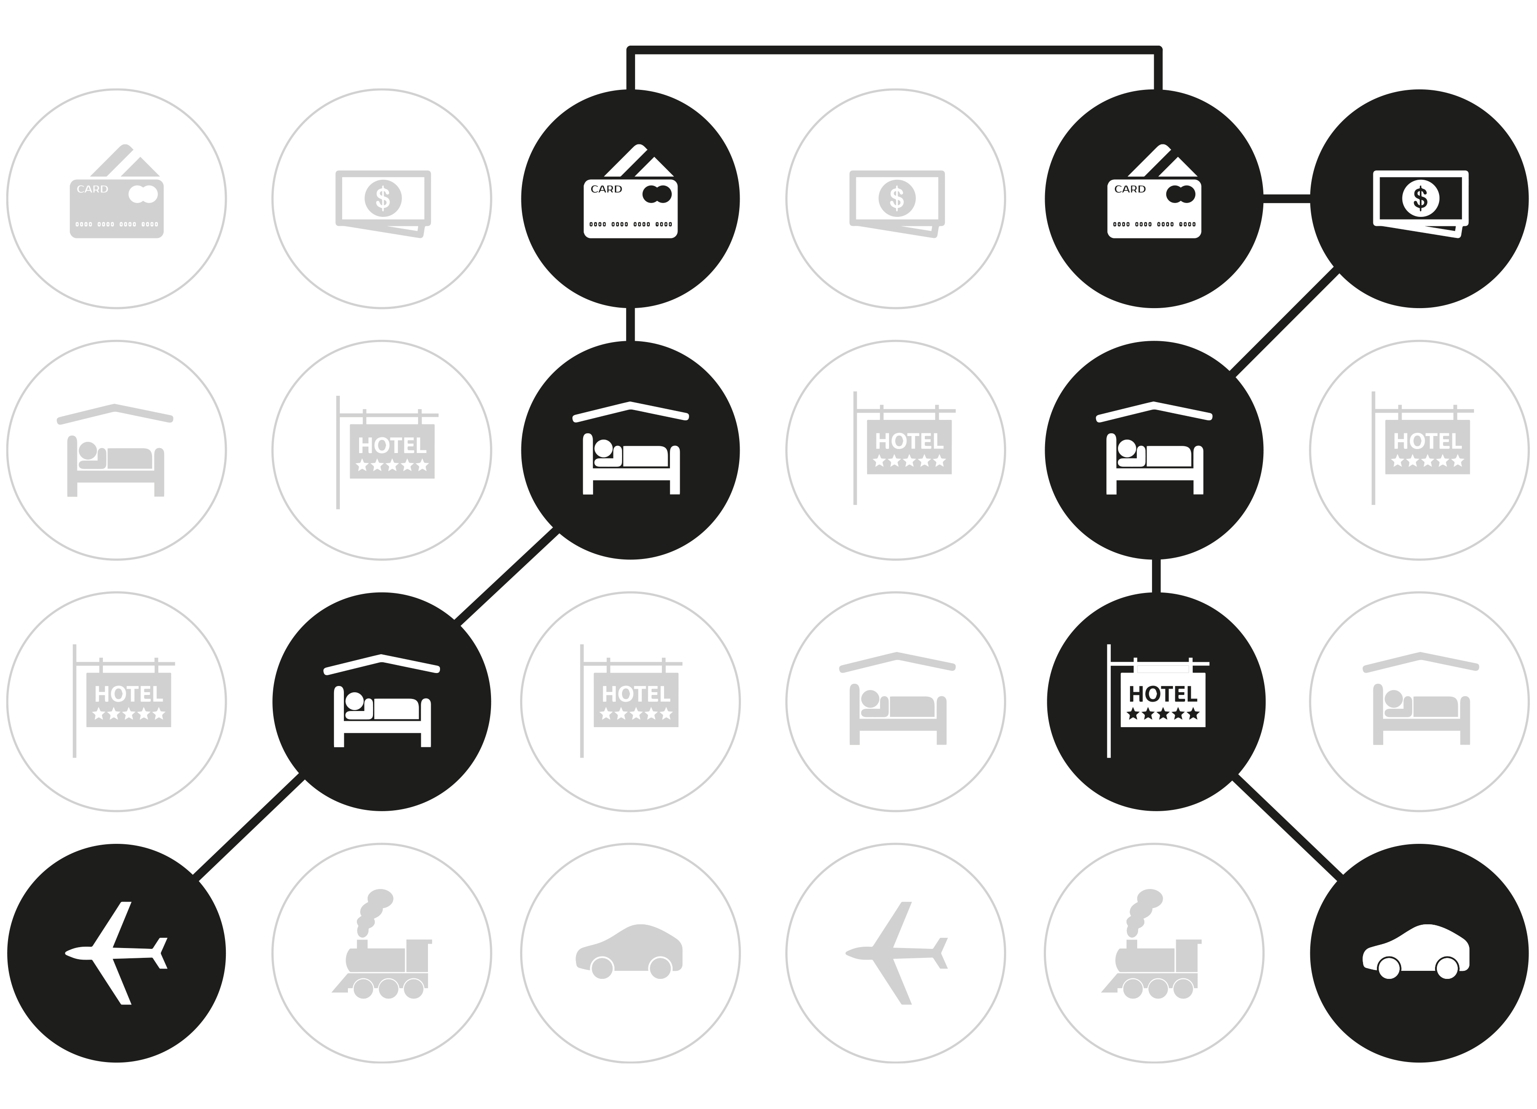
Connecting Data

Slide 15

If you can see the data
You understand what is driving traveller behaviour
Create meaningful and actionable reporting
Generate a complete picture of supplier spend
See the holistic view of trip level costs
And save money

Slide 16
Getting the Data Best Practice Guide

Slide 17
Thank you
Webinar: Getting the most from your data
Our Panel
Keesup Choe
PI
Johanne Young
Opteva
Mark Frary
BTiQ
Download the full report at www.businesstravel-iq.com

